Slide 1

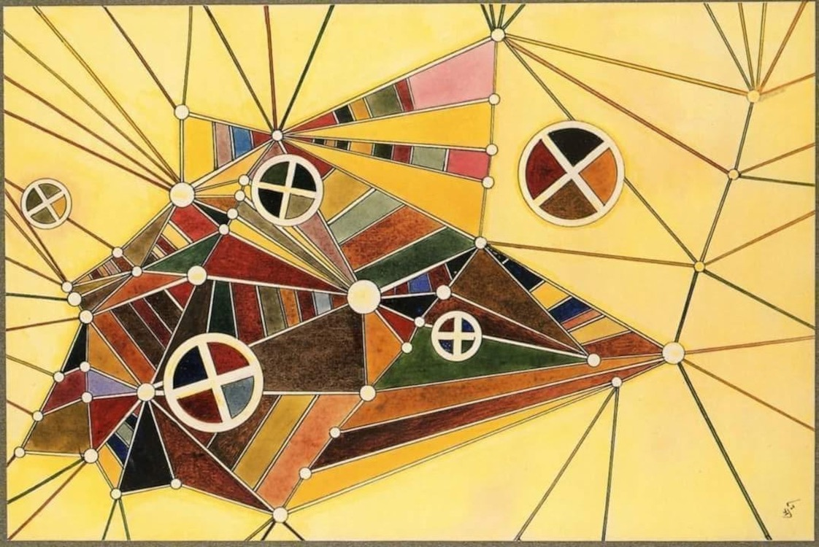
Making friends with AI a socio-ecological approach to understanding how we might relate
Bruce Edmonds
Centre for Policy Modelling,
Manchester Metropolitan University
In the Network by Wassily Kandinsky, 1927 (sideways)

Slide 2
The plan is to talk about…
What I am not going to talk about
Some fundamentals (some of which may be obvious to you, some not)
Some ecological considerations
Some sociological considerations
The prospects for friendship with AI entities

Slide 3
What I am…
NOT talking about:
The near future
AI algorithms as a tool for humans
Current important dangers: e.g. preventing people exploiting other humans using AI
talking about:
A longer-term future
Autonomous, self-maintaining entities
Some ways we might co-exist

Slide 4
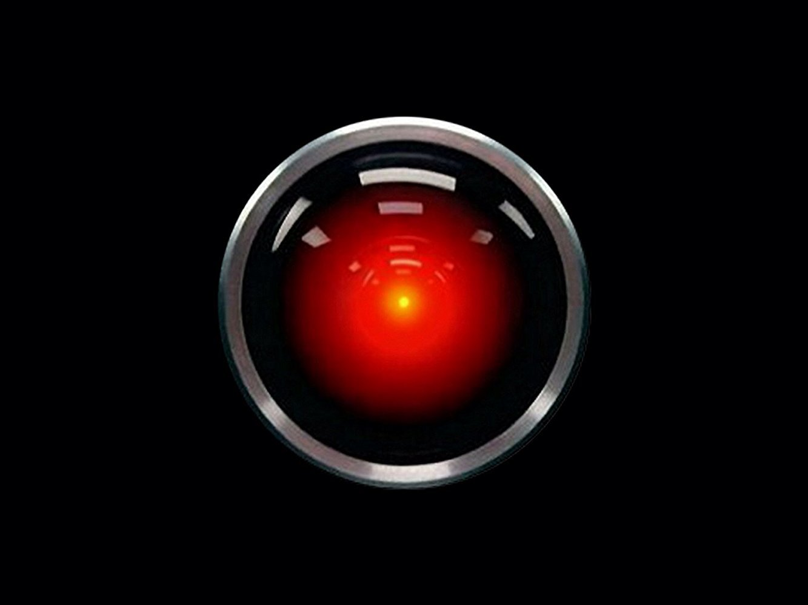
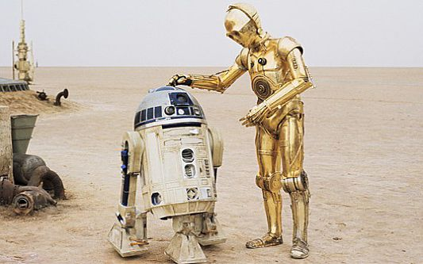
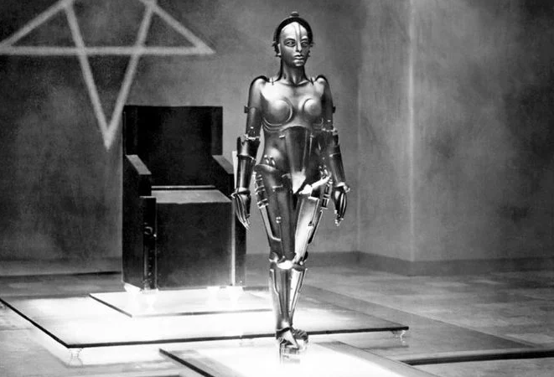
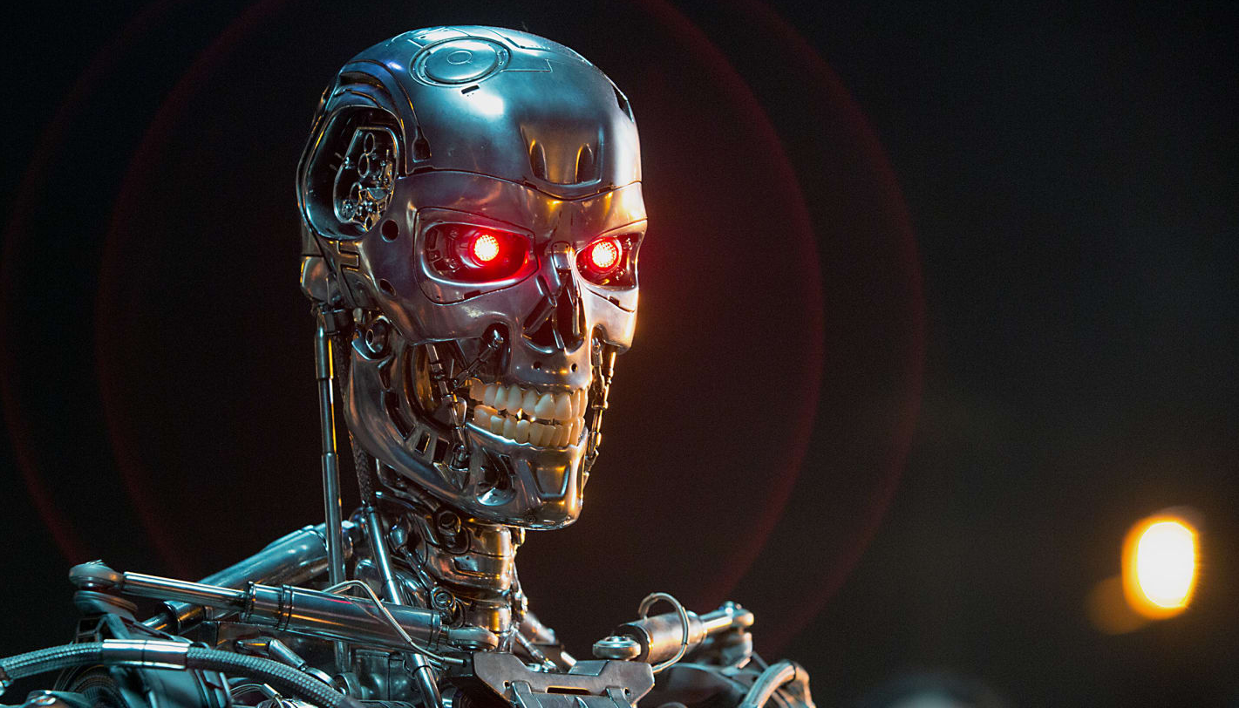
Human stories are not a good guide!
These stories are really about humans not AI/robots
We project what we do onto AI

Slide 5
Computation is universal…
Different models of discrete computation can all be mapped to each other
Computation is indirection – instead of doing computation we do the program for it (or the program for the program etc.)
Computation can be faster or slower, so some compute better than others
Computation can access very large quantities of information/data

Slide 6
…but learning + decision-making is not!
The “No Free Lunch” theorems say…
If a decision has to be made on the basis of a partial data set (the training set)…
Then no algorithm, however clever, is better than others over all situations
What I take from these is the following:
There are always trade-offs, being good at one problem means less good at another
One gets better algorithms (those that make the right decision more of the time) by being specific to the particular problem landscape
However, fixed realities (e.g. physics) can be learnt before hand

Slide 7
Intelligence gives survival value in a particular niche
In evolution, intelligence has a purpose – to give survival advantage in a particular way
This means there are lots of different kinds of intelligence suited to different niches
Human intelligence is no exception – it gives particular abilities that have allowed us to survive (language, social learning, story telling, group-based identity, etc. etc.)
IQ can not be well measured using a 1-Dimensional (i.e. numeric) scale

Slide 8
There is no such thing as “General Intelligence” – human or AI
There is general computation, but not general intelligence as in an ability to make ideal decisions in an uncertain environment
“Artificial General Intelligence” (AGI) is usually defined by achieving human abilities
Thus, it is badly named (probably as a result of human hubris)
There is no “critical point” where AI entities overtake humans

Slide 9
But that does not mean there is no danger from AI entities…
…any more than there is no danger from other humans or from other species (e.g. viruses)
Sometimes different species:
Predate upon others
Compete for the same resources
Co-exist in different niches
Have symbiotic relationships
Which of these can we ensure between AI entities and humans, and how?

Slide 10
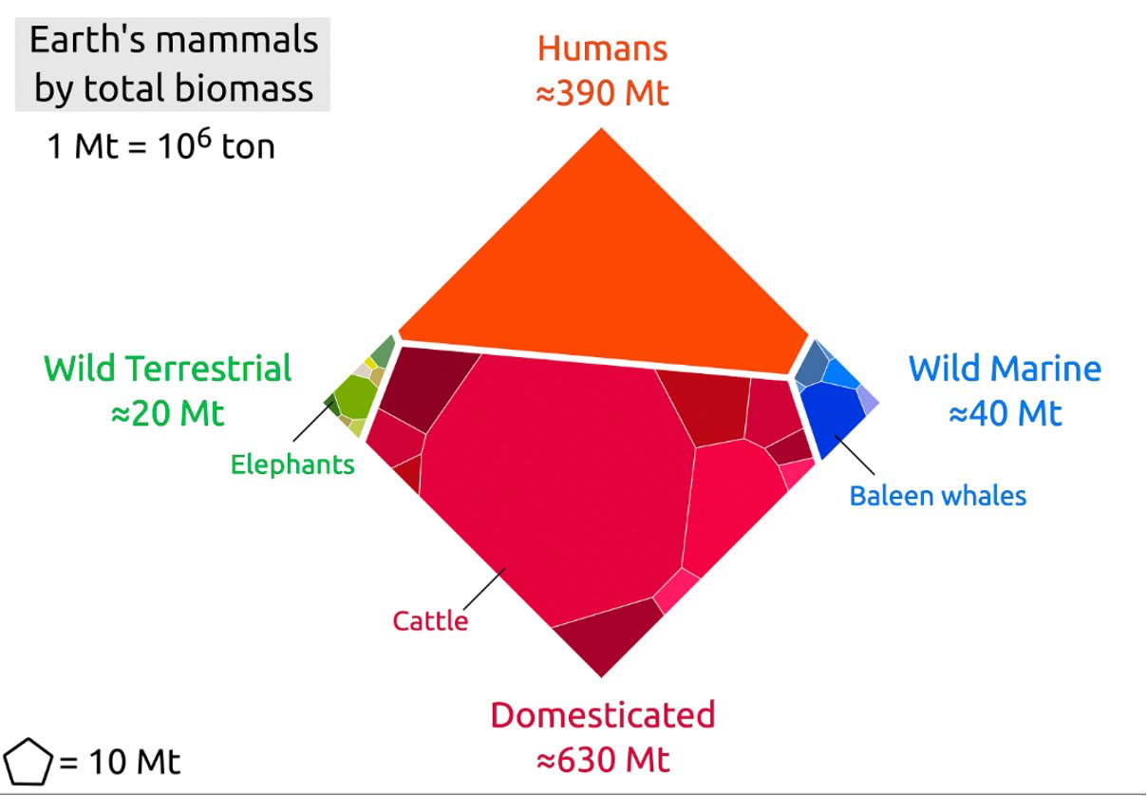
Humans dominate competition with other mammals

Slide 11
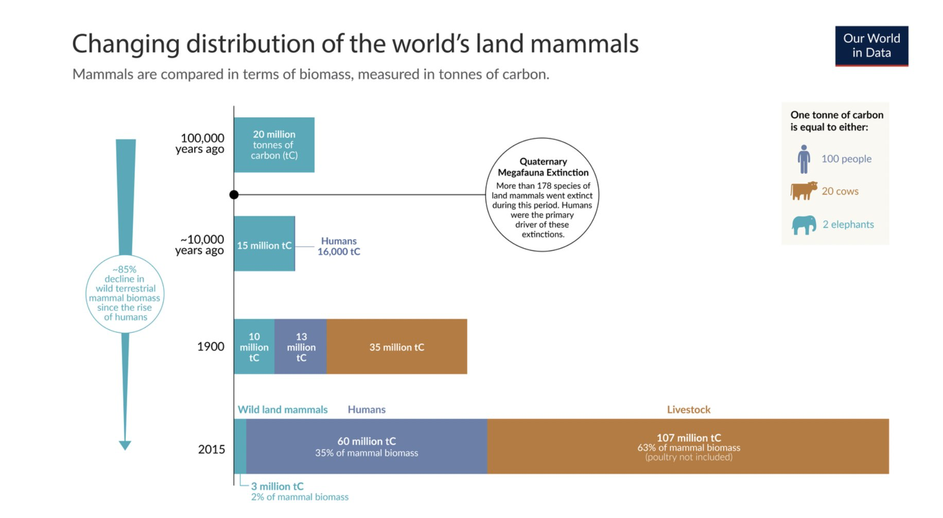
Humans has meant ‘more’ mammal biomass, but with co-evolved species

Slide 12
But we cannot eat AI entities and they cannot eat us
Thus direct predation is not likely
Resource competition is more likely over:
data (but it can be duplicated at no cost)
energy!
We both need increasing amounts of energy and that is (currently) limited in supply (not least due to the global warming it entails)
In a sense, competition for this has already started

Slide 13
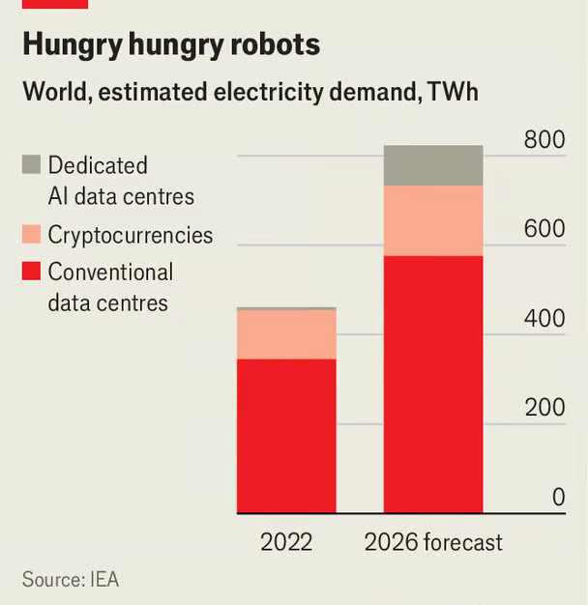
Competition for Energy Resources
Rene Haas, chief executive of Arm (a chip-design company), told the Wall Street Journal this week that: by the end of the decade, AI data centres could consume as much as a quarter of all American electricity, up from 4% or less today.
https://www.economist.com/business/2024/04/11/generative-ai-has-a-clean-energy-problem

Slide 14
Co-existence
If we can ensure enough energy so that both humans and AI entities can be sustained without competition (1) then…
…co-existence is possible if AI entities and humans are different from each other (2) just as very different species can co-exist
Which makes it a mistake to develop AI to duplicate human skills and characteristics
  e.g. using ‘AGI’ as a goal/benchmark
It is unclear if there could be symbiosis, but more likely if we have complementary skills

Slide 15
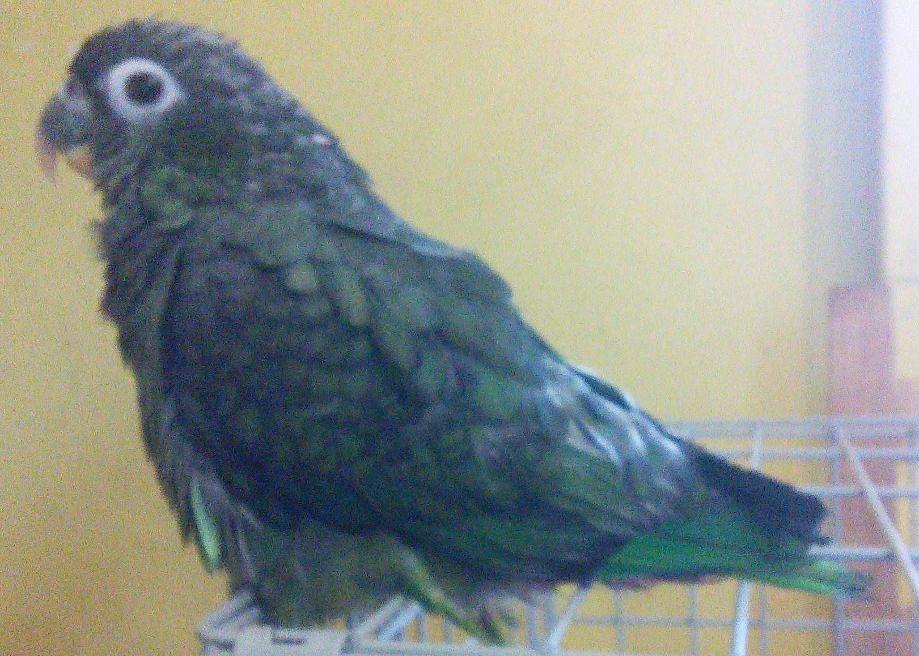
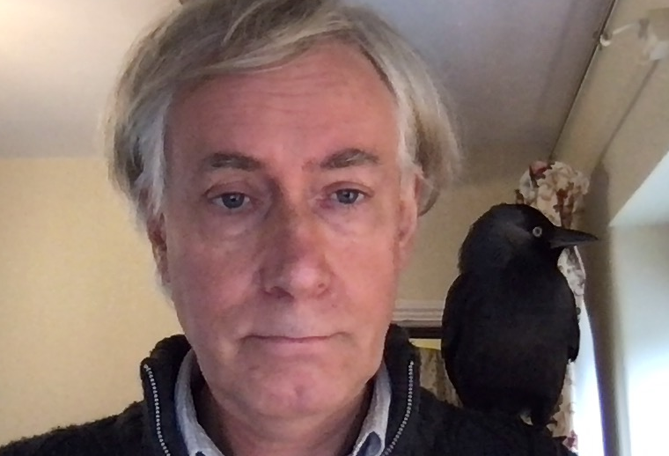
Friendship between species
Other species have friendship relationships
  e.g. mice!
I have had friendships with a
crow, a jackdaw (Boris) and
(currently) a parrot (Stevie)
They are usually, but not always, between individuals of the same species but are always between social animals
Thus the AI entities would have to need to be social for some reason (3), rather than a single self-sustaining individual

Slide 16
What is ‘friendship’?
A relationship that is more than a one-off, thus involves repeated interaction
A need/enjoyment of interaction, e.g.:
  providing interest for each other
  helping each other using own strengths
Time & resources to spend time interacting
Helps to have some commonality, such as mutual projects or activities
Helps if one or other is somewhat adapted to the other’s culture for communication

Slide 17
It is not necessary for friendship that…
We are of the same species
There is an ‘equality’ of intelligence (whatever that might mean)
Our thought processes are transparent to each other (but maybe it is important that we can provide rationalisations of our actions to allow for negotiation)
There is an equivalence of benefit (but there needs to be some benefit both ways)

Slide 18
Back to human hopes & fears…
They would not bother to take over our activities
They will not free us of mundanity
They may not be projections of ourselves
They would not bother to fight us without a reason

Slide 19
There is no inevitability of AI entities ‘terminating’ us just because they are ‘more intelligent’
No
Are the people in charge of most countries the ‘most intelligent’ there?
Were the Europeans ‘more intelligent’ than the people they colonised?
Are the species that pose the greatest threat to humanity the ‘most intelligent’?
There are dangers but not many of the ones projected upon them. Capabilities, adaptability, sociality are more important than ‘intelligence’

Slide 20
Summary of: emerging principles for facilitating friendship with AI entities
For peaceful co-existence:
No competition for resources
Different to humans
For friendship:
Sociality of AI entities important
Some mutual benefit/interest
Some commonality so communication can occur
Some spare time & resources
Maybe mutual projects

Slide 21
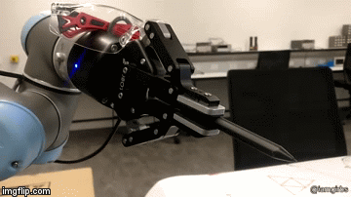

Thank you!
Me: bruce@edmonds.name, @bruceedmonds
Centre for Policy Modelling: http://cfpm.org, @cfpm_org
These slides available at: http://cfpm.org/slides

