Slide 1
Mixing ABM and Policy... What on earth could go wrong?
Bruce Edmonds & Lia ní Aodha
Centre for Policy Modelling
Manchester Metropolitan University

Slide 2




Acknowledgements
Work done with:
Lia ní Aodha
http://goo.gl/3gfWjH
http://saf21.eu
Aodha, L. & Edmonds, B. (2017) Some pitfalls to beware when applying models to issues of policy relevance. In Simulating Social Complexity – a handbook, 2nd Edition. Springer

Slide 3
A Cautionary Tale
On the 2nd July 1992 Canada’s fisheries minister, placed a moratorium on all cod fishing off Newfoundland. That day 30,000 people lost their jobs.
Scientists and the fisheries department throughout much of the 1980s estimated a 15% annual rate of growth in the stock – (figures that were consistently slated by inshore fishermen).
The subsequent Harris Report (1992) said: “..scientists, lulled by false data signals and… overconfident of the validity of their predictions, failed to recognize the statistical inadequacies in … [their] model[s] and failed to … recognize the high risk involved with state-of-stock advice based on … unreliable data series.”

Slide 4
What had gone wrong?
“… the idea of a strongly rebuilding Northern cod stock that was so powerful that it …[was]... read back… through analytical models built upon necessary but hypothetical assumptions about population and ecosystem dynamics. Further, those models required considerable subjective judgement as to the choice of weighting of the input variables” (Finlayson 1994, p.13)
Finlayson concluded that the social dynamics between scientists and managers were at play
Scientists adapting to the wishes and worldview of managers, managers gaining confidence in their approach from the apparent support of science

Slide 5
This talk….
Discusses some of the pitfalls around when modelling and policy making work together
Suggests an approach which might help avoid these pitfalls

Slide 6
Some Pitfalls in Model Construction
Part 1

Slide 7
Modelling Assumptions
All models are built on assumptions, but…
They have different origins and reliability, e.g.:
Empirical evidence
Other well-defined theory
Expert Opinion
Common-sense
Tradition
Stuff we had to assume to make the model possible
Choosing assumptions is part of the art of simulation but which assumptions are used should be transparent and one should be honest about their reliability – plausibility is not enough!

Slide 8
Theoretical Spectacles
Our conceptions and models constrain how we
look for evidence (e.g. where and what kinds)
what kind of models we develop
how we evaluate any results
This is Kuhn’s “Theoretical Spectacles” (1962)
e.g. continental drift
This is MUCH stronger for a complex simulation we have immersed ourselves in
Try to remember that just because it is useful to think of the world through our model, this does not make them valid or reliable

Slide 9
Over-Simplified Models
Although simple models have many pragmatic advantages (easier to check, understand etc.)…
If we have missed out key elements of what is being modelled it might be completely wrong!
Playing with simple models to inform formal and intuitive understanding is an OK scientific practice
…but it can be dangerous when informing policy
Simple does not mean it is roughly correct, or more general or gives us correct intuitions
Need to accept that many modelling tasks requested of us by policy makers are not wise to do with restricted amounts of time/data/resources

Slide 10
Underestimating model limitations
All models have limitations
They are only good for certain things: a model that explains well might not predict well
The may well fail when applied in a different context than the one they were developed in
Policy actors often do not want to know about limitations and caveats
Not only do we have to be 100% honest about these limitations, but we also have to ensure that these limitations are communicated

Slide 11
Not checking & testing a model thoroughly
Doh!
Sometimes there is not a clear demarcation between an exploratory phase of model development and its application to serious questions (whose answers will impact on others)
Sometimes an answer is demanded before thorough testing and checking can be done – “Its OK, I just want an approximate answer” :-/
Sometimes researchers are not honest
Depends on the potential harm if the model is relied on (at all) and turns out to be wrong

Slide 12
Some Pitfalls in Model Application
Part 2

Slide 13
Insufficiently Validated Models
One can not rely on a model until it has been rigorously checked and tested against reality
Plausibility is nowhere NEAR enough
This needs to be on more than one case
Its better if this is done independently
You can not validate a model using one set of settings/cases then rely on it in another
Validation usually takes a long time
Iterated development and validation over many cycles is better than one-off models (for policy)

Slide 14
Promising too much
Modellers are in a position to see the potential of their work, and so can tantalise others by suggesting possible/future uses (e.g. in the conclusions of papers or grant applications)
They are tempted to suggest they can ‘predict’, ‘evaluate the impact of alternative polices’ etc.
Especially with complex situations (that ABM is useful for) this is simply deceptive
‘Giving a prediction to a policy maker is like giving a sharp knife to a child’

Slide 15
The inherent plausibility of ABMs
Due to the way ABMs map onto reality in a common-sense manner (e.g. people⇔agents)…
…visualisations of what is happening can be readily interpretted by non-modellers
and hence given much greater credence than they warrant (i.e. the extent of their validation)
It is thus relatively easy to persuade using a good ABM and visualisation
Only we know how fragile they are, and need to be especially careful about suggesting otherwise

Slide 16
Model Spread
On of the big advantages of formal models is that they can be passed around to be checked, played with, extended, used etc.
However once a model is out there, it might get used for different purposes than intended
e.g. the Black-Scholes model of derivative pricing
Try to ensure a released model is packaged with documentation that warns of its uses and limitations

Slide 17
Narrowing the evidential base
The case of the Newfoundland cod, indicates how models can work to constrain the evidence base, therefore limiting decision making
If a model is considered authoritative, then the data it uses and produces can sideline other sources of evidence
Using a model rather than measuring lots of stuff is cheap, but with obvious dangers
Try to ensure models are used to widen the possibilities considered, rather than limit them

Slide 18
Other/General Pitfalls
Part 3

Slide 19
Confusion over model purpose
A model is not a picture of reality, but a tool
A tool has a particular purpose
A tool good for one purpose is probably not good for another
These include: prediction, explanation, as an analogy, an illustration, a description, for theory exploration, or for mediating between people
Modellers should be 100% clear under which purpose their model is to be judged
Models need to be justified for each purpose separately

Slide 20
When models are used out of the context they were designed for
Context matters!
In each context there will be many conditions/assumptions we are not even aware of
A model designed in one context may fail for subtle reasons in another (e.g. different ontology)
Models generally need re-testing, re-validating and often re-developing in new contexts

Slide 21
What models cannot reasonably do
Many questions are beyond the realm of models and modellers but are essentially
ethical
political
social
semantic
symbolic
Applying models to these (outside the walls of our academic asylum) can confuse and distract

Slide 22
The uncertainty is too great
Required reliability of outcome values is too low for purpose
Can be due to data or model reasons
Radical uncertainty is when its not a question of degree but the situation might fundamentally change or be different from the model
Error estimation is only valid in absence of radical uncertainly (which is not the case in almost all ecological, technical or social simulations)
Just got to be honest about this and not only present ‘best case’ results

Slide 23
A false sense of security
If the outcomes of a model give a false sense of certainly about outcomes then a model can be worse than useless; positively damaging to policy
Better to err on the side of caution and say there is not good model in this case
Even if you are optimistic for a particular model
Distinction here between probabilistic and possibilistic views

Slide 24
Not more facts, but values!
Sometimes it is not facts and projections that are the issue but values
However good models are, the ‘engineering’ approach to policy (enumerate policies, predict impact of each, choose best policy) might be inappropriate
Modellers caught on the wrong side of history may be blamed even though they were just doing the technical parts

Slide 25
A Socio-Ecological Test Bed – general description
Part 4

Slide 26
An uncertainty-analysis approach
Give up on predicting future impact of policies
Make simulation models that include more of the observed complication and complex interactions
Run these lots of times with various scenarios to discover some of the ways in which things can go surprisingly wrong (or surprisingly right)
Put in place sensors/measures that would give us the earliest possible warning that these might be occurring in real life
React quickly if these warning emerge

Slide 27
This example model…
…is a dynamic, spatial, individual-based ecological model that has some of the complexity, adaptability and fragility of observed ecological systems with emergent outcomes
It evolves complex, local food webs, endogenous shocks from invasive species, is adaptive but unpredictable as to the eventual outcomes
Into this the impact of humans can be imposed or even agents representing humans ‘injected’ into the simulation
The outcomes can be then analysed at a variety of levels over long time scales, and under different scenarios
Paper: Edmonds, B. (2019) A Socio-Ecological Test Bed. Ecological Complexity, Vol 40 part B. DOI:10.1016/j.ecocom.2018.10.003
Full details and code at: http://openabm.org/model/4204

Slide 28
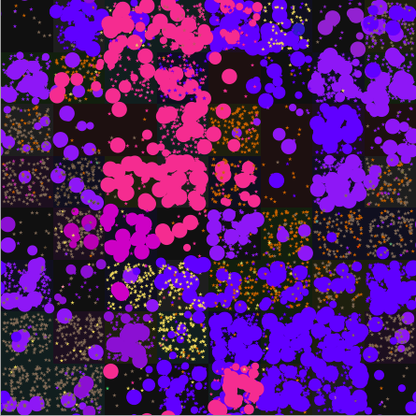
The Model
Each individual represented separately
Slow random rate of migration between patches
A well-mixed patch
A wrapped 2D grid of well-mixed patches with:
energy (transient)
bit string of characteristics
Organisms represented individually with its own characteristics, including:
bit string of characteristics
energy
position
stats recorders

Slide 29
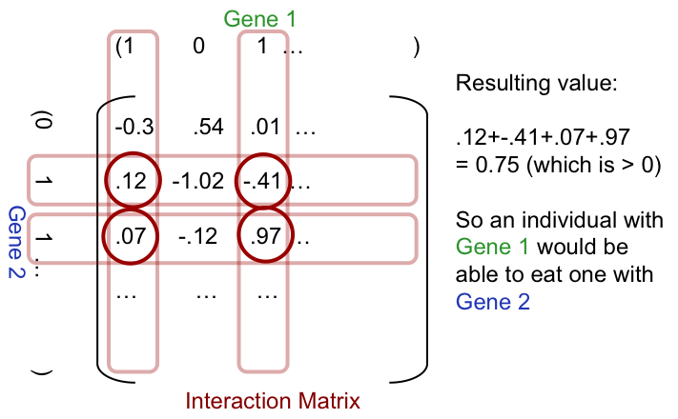
How Dominance is Decided
(Caldarelli, Higgs, and McKane 1998)

Slide 30
Model sequence each simulation tick
Input energy equally divided between patches.
Death. A life tax is subtracted, some die, age incremented
Initial seeding. until a viable is established, random new individual
Energy extraction from patch. energy divided among the individuals there with positive score when its bit-string is evaluated against patch
Predation. each individual is randomly paired with a number of others on the patch, if dominate them, get a % of their energy, other removed
Maximum Store. energy above a maximum level is discarded.
Birth. Those with energy > “reproduce-level” gives birth to a new entity with the same bit-string as itself, with a probability of mutation, Child has an energy of 1, taken from the parent.
Migration. randomly individuals move to one of 4 neighbours
Statistics. Various statistics are calculated.

Slide 31
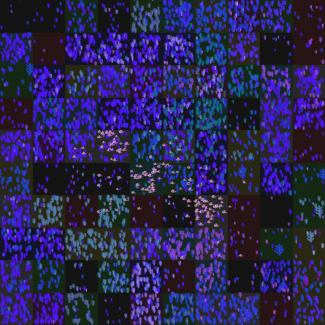
Demonstration of the basic model

Slide 32
First, evolve a rich mixed ecology
Evolve and save a suitable complex ecology with a balance of tropic layers (final state to the left with log population scale)

Slide 33
Then explore starting from there
Do multiple runs of the simulation starting from there for each condition to test
Evolve a complex ecology and save this state
After, collect statistics or visualisations about what happened in the runs to understand the possible paths

Slide 34
Application to fisheries collapses
Part 5

Slide 35
In this version of the model
Plants and higher order entities (fish) distinguished (no photosynthesizing herbivores!)
First a rich competing plant ecology is evolved
Then single fish injected until fish take hold and evolve until there is an ecology of many fish species, run for a bit to allow ‘transients’ to go
This state then frozen and saved
From this point different ‘fishing’ polices implemented and the simulations then run lots of time with the outcomes then analysed

Slide 36
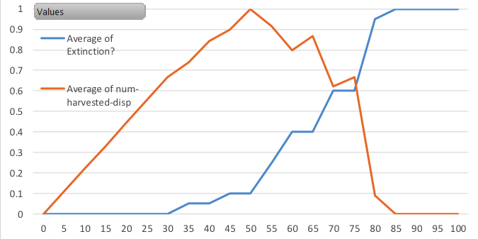
Total Extinction Prob. & Av. Total Harvest (last 100 ticks) run 20 times for different catch levels
Proportion of Maximum
Catch level (per tick)

Slide 37
Num Fish (all species, 20 runs) – catch level 25

Slide 38
Num Fish (all species, 20 runs) – catch level 35

Slide 39
Num Fish (all species, 20 runs) – catch level 50

Slide 40
Average Number of Fish Species vs. Catch Level (from a different starting ecology)

Slide 41
Average Number of Species, Catch=20

Slide 42
Average Number of Species, Catch=30

Slide 43
Average Number of Species, Catch=40

Slide 44
Conclusion
Unless we are careful, modellers can make problems worse in a number of ways…
…mostly due to the ways modellers and the policy world interact
We should stop implying we can predict anything about complex systems, even roughly
And not use the word ‘predict’ when we mean ‘explain’, ‘fit data’ or describe model outcomes
A way forward is to focus on the risk/uncertainty analysis of policy – the ways it could go wrong

Slide 45

The End!
Centre for Policy Modelling: http://cfpm.org
These slides at: http://cfpm.org/slides
Paper on the dangers at: http://cfpm.org/discussionpapers/236
The basic model (without “humans” or “fishing”) is available at: http://openabm.org/model/4204
Paper about the model: http://cfpm.org/discussionpapers/221

