Slide 1
Issues in Modelling the Hawala System
Bruce Edmonds
Centre for Policy Modelling
Manchester Metropolitan University

Slide 2
Aim of Simulation
To understand the dynamics and mechanisms that underlie the Hawala system of exchange
Purpose was to reveal questions about Hawala that are either (a) unknown (by me!) or (b) critical to its success
And thus help direct further search for evidence to aid the development of a simulation that integrates as much of the evidence (expert, qualitative, statistics etc.) as possible – a Data-Integration Model
This work is only beginning, and thus the purpose of this presentation is to elicit comments concerning:
this approach,
what this model should look like,
kinds of evidence I might use
how this might fit in a broader project of understanding social phenomena that involve value transfer

Slide 3
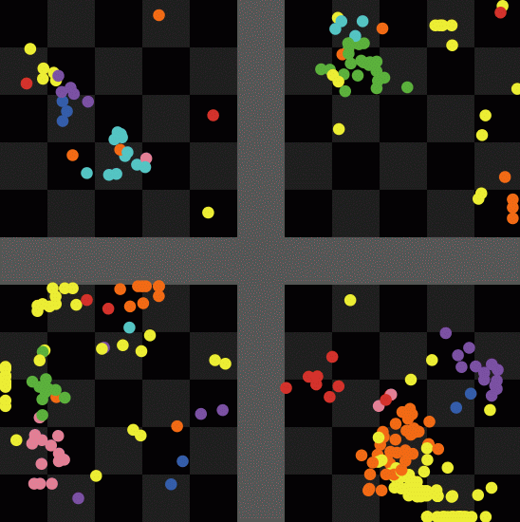
Simple model environment
Gradual development of extended clans over patches in four countries by spawning, relocation and death

Slide 4
Transfers
Only rich agents have bank accounts
Can only do inter-country transfers using bank accounts, but is costly for small amounts

Slide 5
Key Ideas
Clans slowly multiply locally up to a world population limit (after that random agents die to keep it there)
Agents occasionally migrate
Fixed costs plus different income levels lead to some rich agents and some agents with negative money
Each time step, rich agents take on an obligation to send money to a relative in debt
Only some have bank accounts to allow inter-country transfers (those that are sufficiently rich)
Agents seek ways to send this money based on a mixture of criteria: trust and cost
Within a clan the instruction to deliver money happens immediately and then the clan settles up internally later, based on trust that demands for money and payments into the systems are correct!

Slide 6
In the current (unsatisfactory) model
There is no trade to balance flows of remittances
Routes are determined in a stupid fashion, i.e. simply look for a family member with a bank account as the “consolidating” hawala agent and hopes there is another family member in the required country
No reputation system to underpin trust of clans, it is simply assumed

Slide 7
Key Questions this uncovered
How do actors discover and pass on information concerning possible routes?
How do Hawala agents decide the customer price since they might not know the route and hence cost of the actual chain of transfers?
Is there competition between clans or also within clans?
How does the information concerning which direction to settle-up accounts pass up the pyramids of consolidation in each country to enable the settling at the top?
How are multidirectional swaps decided at the top?

Slide 8
Suggestions as to ways forward
Generalising the mechanisms under consideration to include social aspects
Look at a wider class of social system that those with classic monetary purchase and payment supported by legal means
Going back to the basic principles of what we want from systems (e.g. trust in banks_
Starting more from what is observed rather than theoretical commitments even if this is of kinds not usually used by modellers (i.e. including qualitative narrative accounts, stakeholder opinion etc.)
Mixing models of a variety of kinds and levels of abstraction
Involving experts from several different domains: cognitive, anthropological, sociological, simulation, mathematicians etc.

Slide 9
Example Systems based on “Social” mechanisms for reliability
Hawala/Hundi systems
Micro-credit lending
Informal lending/sharing between friends and within families
New systems of value transfer on the internet
Using goods to consolidate value transfer to/from Somalia
Baby-sitting circles
Payments in-kind
Local currencies
Almost all Economic systems!

Slide 10
Social Systems use a Mix of Mechanisms
The inverted icebergs of social phenomena
Social Conventions
Habits, Imitation
Norms
Reputation, Personal Friendship
Laws
Internal clan sanction

