Slide 1
Making Use of Mental models to Capture Human Adaptation Behavior
Sara Mehryar
Grantham Research Institute on Climate Change and the Environment, LSE
Qual2Rule Seminars
7 December 2021

Slide 2
My background
BSc and MSc in Architecture and Urban Planning (Iran and Netherlands)
PhD in Environmental Management and Climate Change adaptation (University of Twente, NL)
Title: Participatory Policy Analysis for Climate Change Adaptation
Post-doctoral Researcher (Research Officer) in Grantham Research Institute, LSE
Zurich Flood Resilience Alliance project:
Measuring and evaluating flood resilience of communities
Supporting decision-making for flood resilience in OECD urban areas
Lowestoft, UK, 2013 – @Paul Nichols
Kuwait City, Kuwait, 2018 – @Hamad M. Alsahli

Slide 3
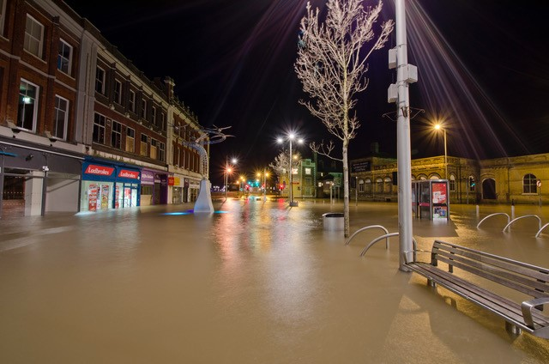
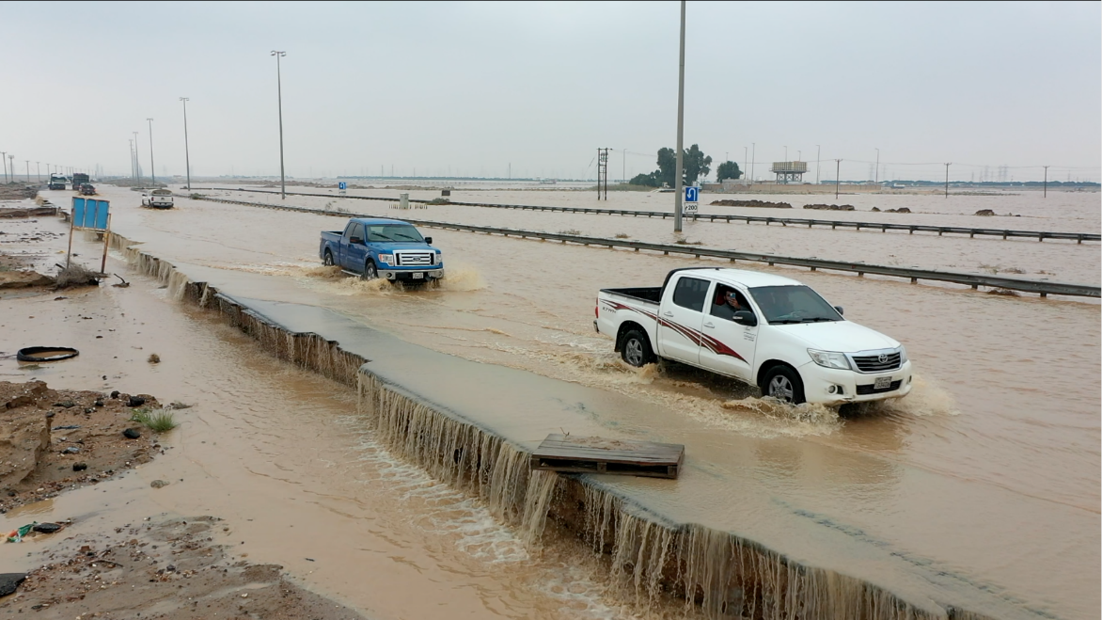
My Research
Flood resilience: capacity of a system, community, or society to absorb shocks, and cope with and recover from their impacts in a timely and efficient manner.
Lowestoft, UK, 2013 – @Paul Nichols
Kuwait City, Kuwait, 2018 – @Hamad M. Alsahli

Slide 4
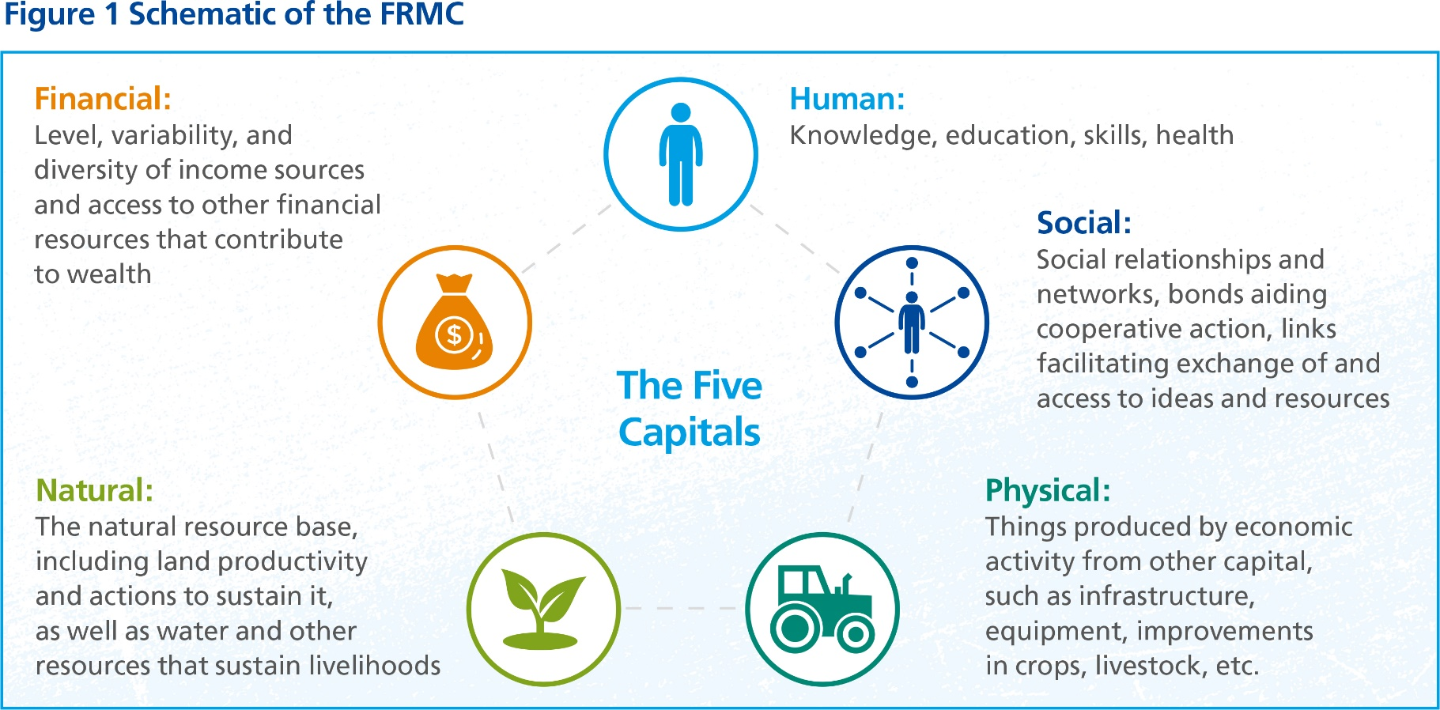
5 capitals of flood resilience

Slide 5
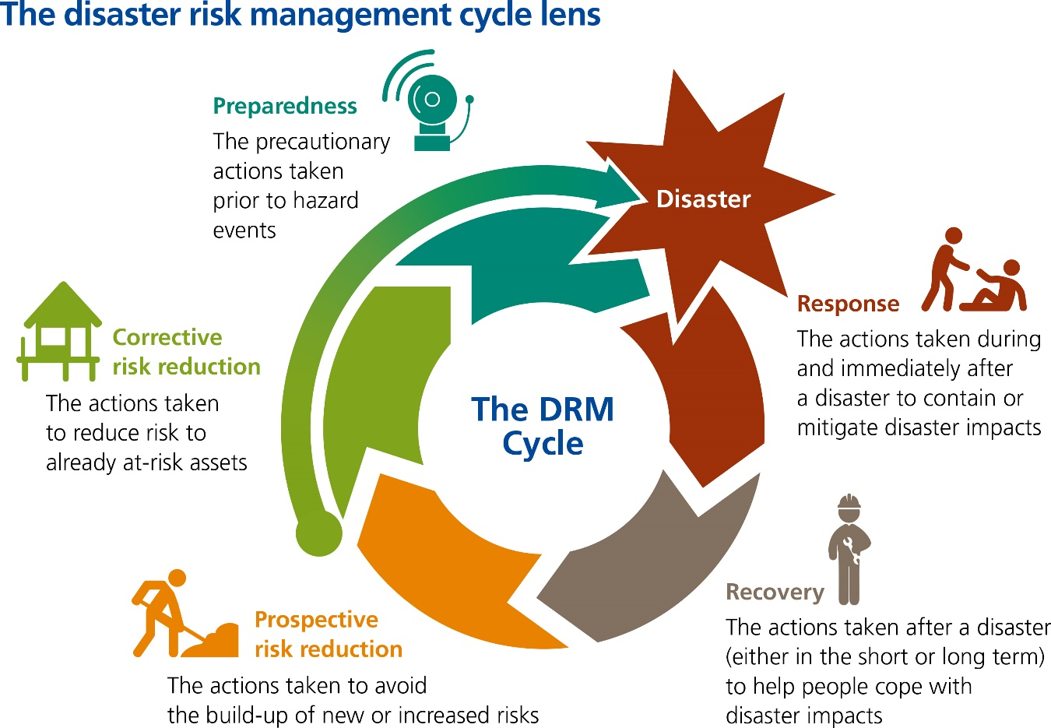
Pro-active flood risk management to reduce exposure and vulnerability

Slide 6
Decision-making for adaptation and resilience
Decisions and actions for adaptation and resilience:
At individual/property-level, community level, city-level
Short term vs long-term
Risk reduction vs coping strategies
Structural and physical protection vs non-structural measures
Question: What measures/actions/interventions should be taken when, where, and for whom?

Slide 7
Decision-making for adaptation and resilience
Traditional policy analysis methods for climate change adaptation
rely on cost-benefit analysis or feasibility appraisal
Participatory policy analysis methods for climate change adaptation
Integrate human behaviour e.g. knowledge, perceptions, preferences and decision-making in the process of decision making

Slide 8
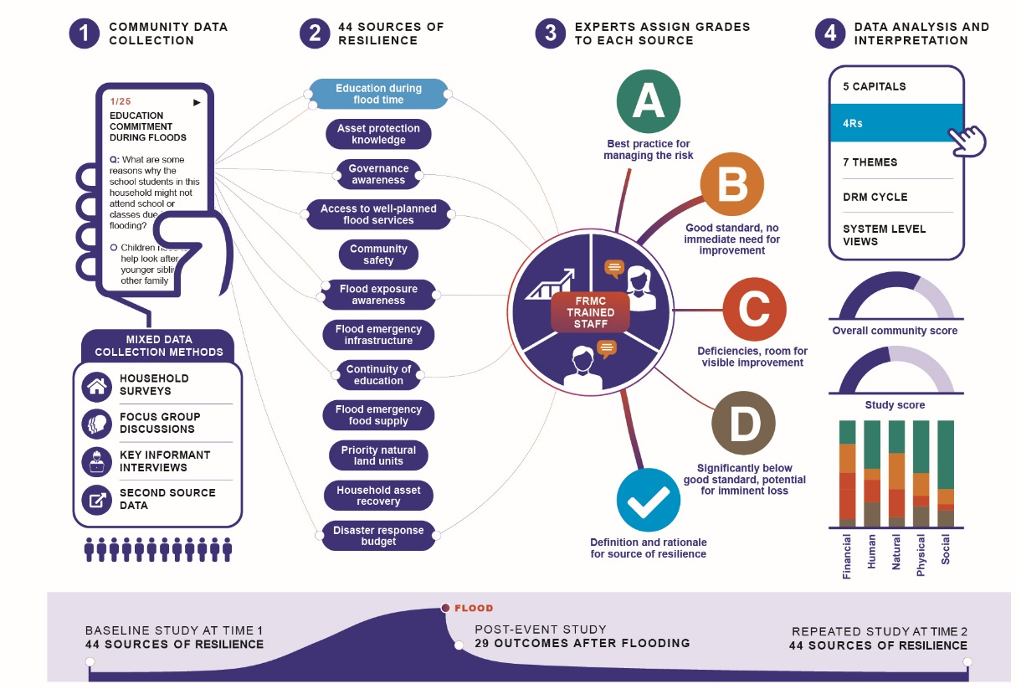
Participatory methods to support decision-making
Flood Resilience Measurement for Communities (FRMC) developed by Zurich Flood Resilience Alliance
https://floodresilience.net/frmc/

Slide 9
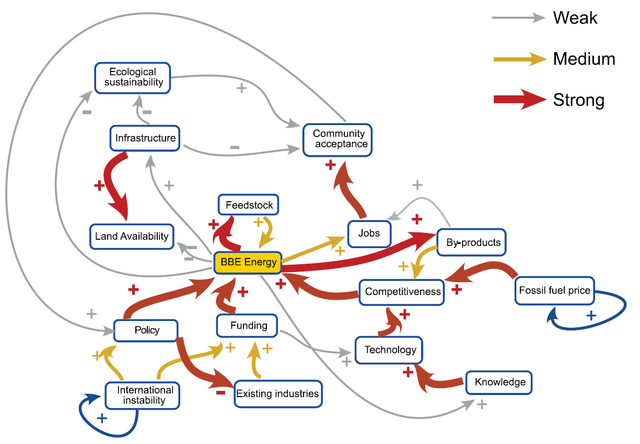
Mind mapping/ Mental modelling
Represent people’s knowledge and perception on how the system functions → In most cases we internally use these mental models to reason and decide
Examples of using mind maps/mental models:
Knowledge co-production to provide holistic representation of system
Compare different perspectives on a common issue
Changes of human mental models over time
Supporting collective decision-making by including various priorities and preferences
Source: steerplex project - http://steerplex.org.uk/tools/today-tools/fuzzy-cognitive-maps-fcm

Slide 10
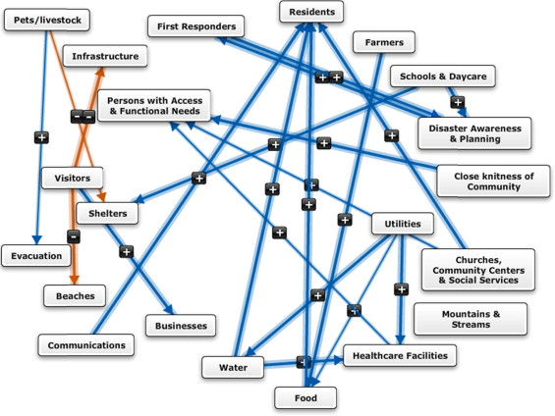
Fuzzy Cognitive Mapping (FCM)
A combination of cognitive/mind mapping and fuzzy logics
Connections represent the causal relations
Negative and positive connections
Value of connections show the strength/level of causal relations
Verbal values (low, very low, high, very high, …) are translated into numbers and normalized between -1 and 1
Source: Henly-Shepard et al, 2015

Slide 11
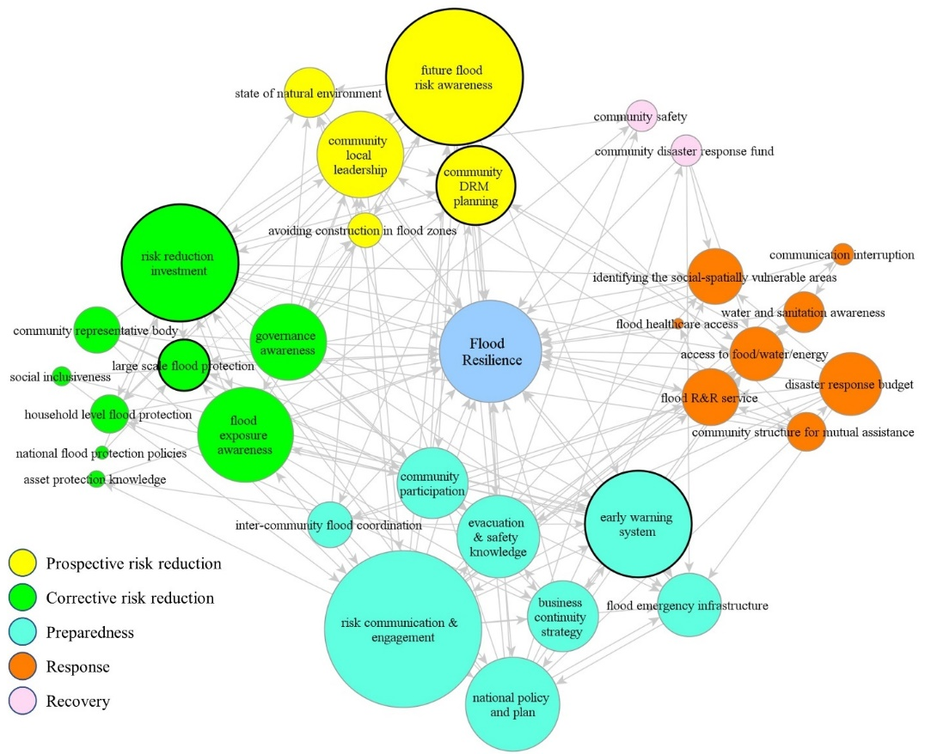
Fuzzy Cognitive Mapping (FCM)
Collective decision-making for flood resilience in Lowestoft, UK
Building flood protection (walls and barriers) as the first choice and most voted action
Risk communication and engagement as the most impactful action
Source: Mehryar and Surminski, 2021

Slide 12
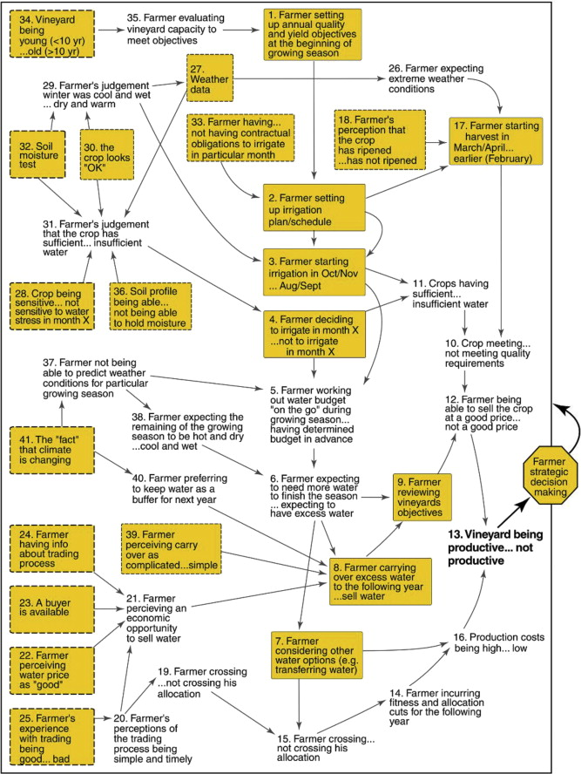
Examples
Elsawah et al, 2015:
Collective map of farmers’ decision-making
solid boxes: decisions or actions
dashed boxes: drivers or trigger nodes
oval nodes: objectives
Elsawah, S., Guillaume, J.H., Filatova, T., Rook, J. and Jakeman, A.J., 2015. A methodology for eliciting, representing, and analysing stakeholder knowledge for decision making on complex socio-ecological systems: From cognitive maps to agent-based models. Journal of environmental management, 151, pp.500-516

Slide 13
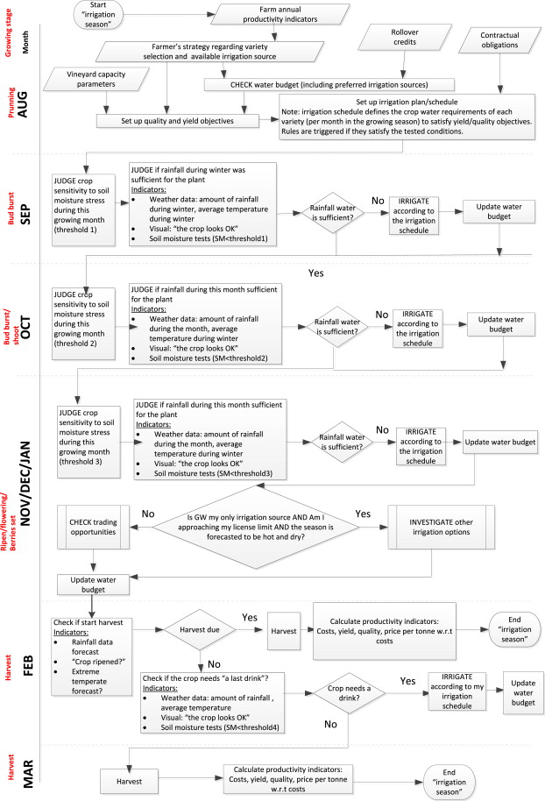
Examples
UML time–sequence diagram of farmers’ decision making during a season.
Elsawah, S., Guillaume, J.H., Filatova, T., Rook, J. and Jakeman, A.J., 2015. A methodology for eliciting, representing, and analysing stakeholder knowledge for decision making on complex socio-ecological systems: From cognitive maps to agent-based models. Journal of environmental management, 151, pp.500-516

Slide 14
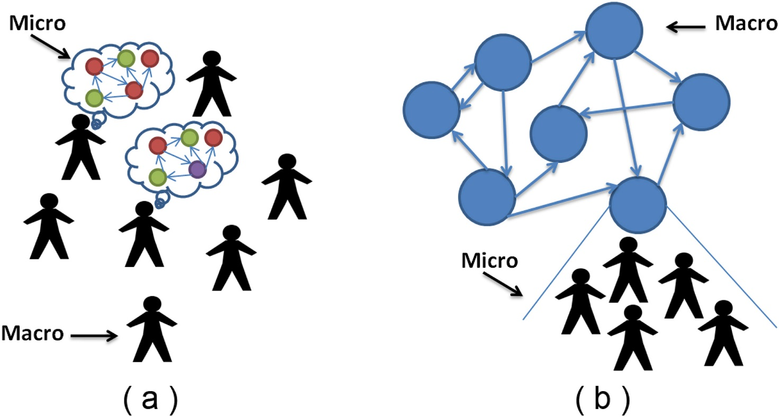
Examples
Two different ways of combining FCM and ABM:
representing each agent's mental model with an FCM (a), or
extending selected concepts of an FCM using an ABM (b)
Giabbanelli, P.J., Gray, S.A. and Aminpour, P., 2017. Combining fuzzy cognitive maps with agent-based modeling: Frameworks and pitfalls of a powerful hybrid modeling approach to understand human-environment interactions. Environmental modelling & software, 95, pp.320-325.

Slide 15
Objective and research questions
Objective
to develop and demonstrate participatory policy analysis methods to support policy-making in climate change adaptation
Questions:
How to:
represent perception, preferences, and decision making of stakeholders in one simulation model
involve qualitative knowledge in policy analysis
integrate qualitative and quantitative evidence for policy option analysis

Slide 16
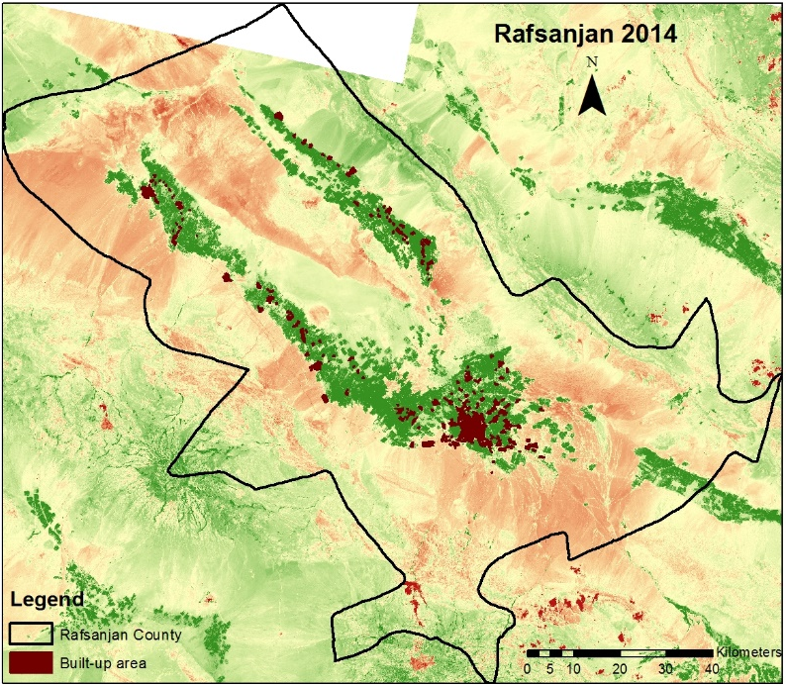
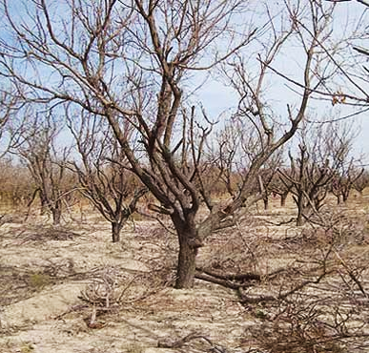
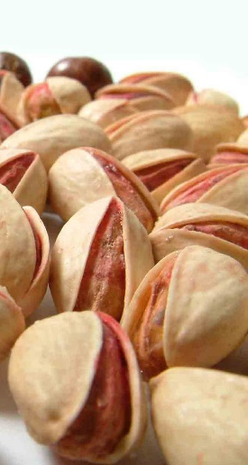
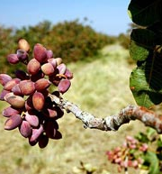
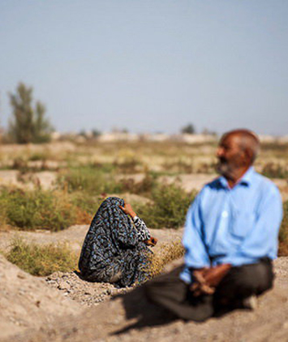
Case study
Rafsanjan Township, Iran
Farming community facing water scarcity
Top producer of pistachio
Main source of income
99% pistachio farms
95% groundwater supply

Slide 17
Decision-making for water scarcity in Rafsanjan
Multi-factorial and multi-stakeholders
Environmental, economic, social, political
Farmers, local and national policy makers (agriculture, water and environmental departments)
Policies for water scarcity mitigation/adaptation
Economic diversification
Irrigation system change
Reducing farmers’ area
Wells control and monitoring
Increasing people participation in WM

Slide 18
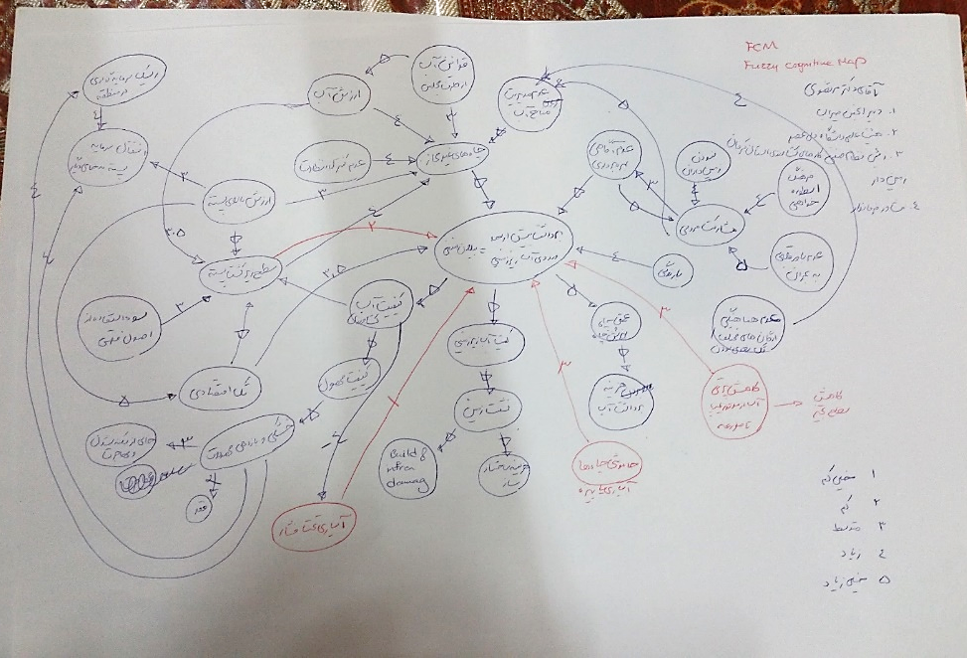
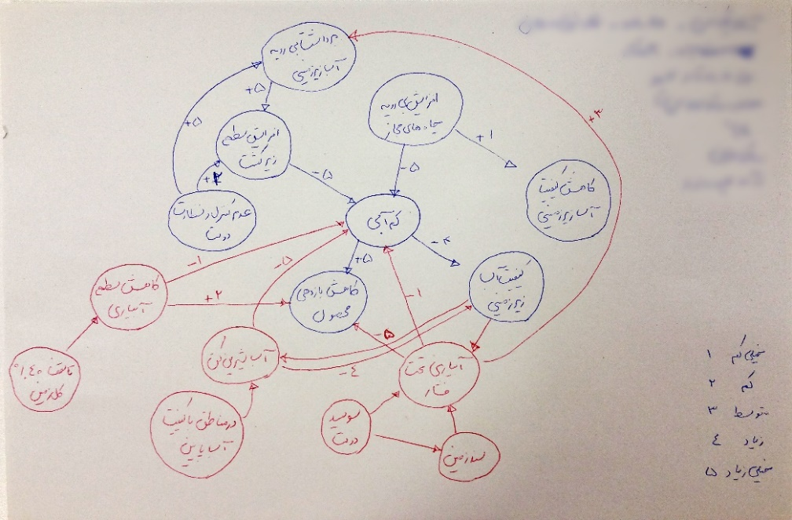
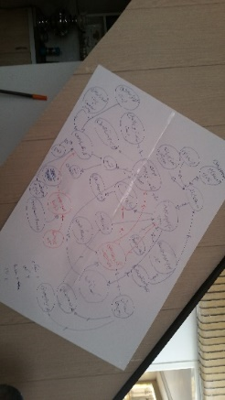
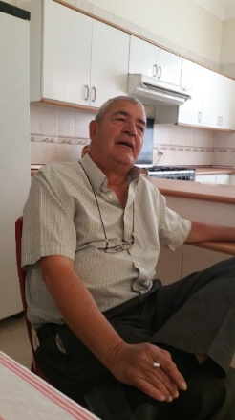
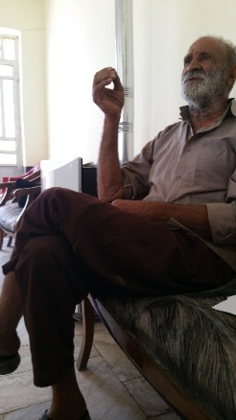
Developing FCMs
Mind-mapping with 60 farmers and 40 policy makers
Causes and impacts of water scarcity and their causal relationships
Adaption actions and their impacts

Slide 19
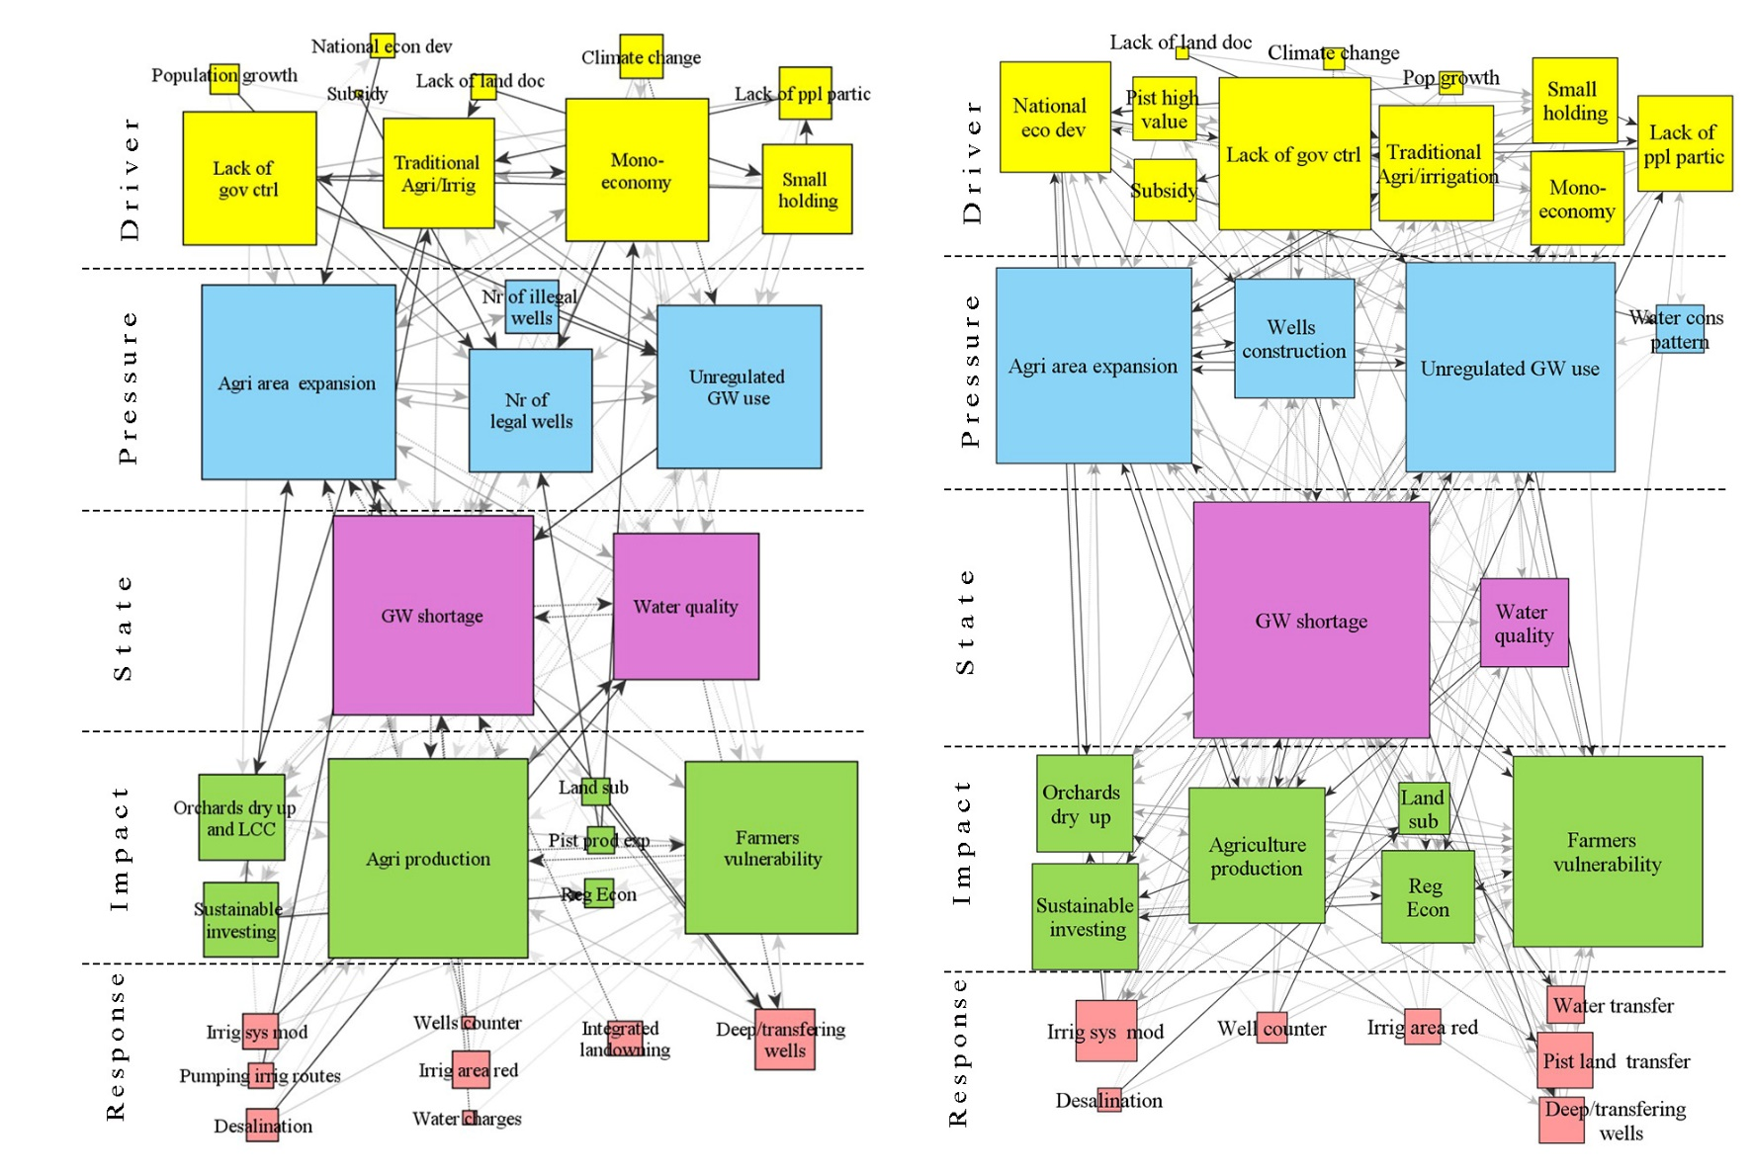
Policy makers’ FCM
Farmers’ FCM

Slide 20
Farmers’ perception of Driver concepts
Policy makers’ perception of Driver concepts

Slide 21
Using FCMs to develop behavioral rules
Behavioral Rules
Available Actions
Impacts of Actions
21

Slide 22
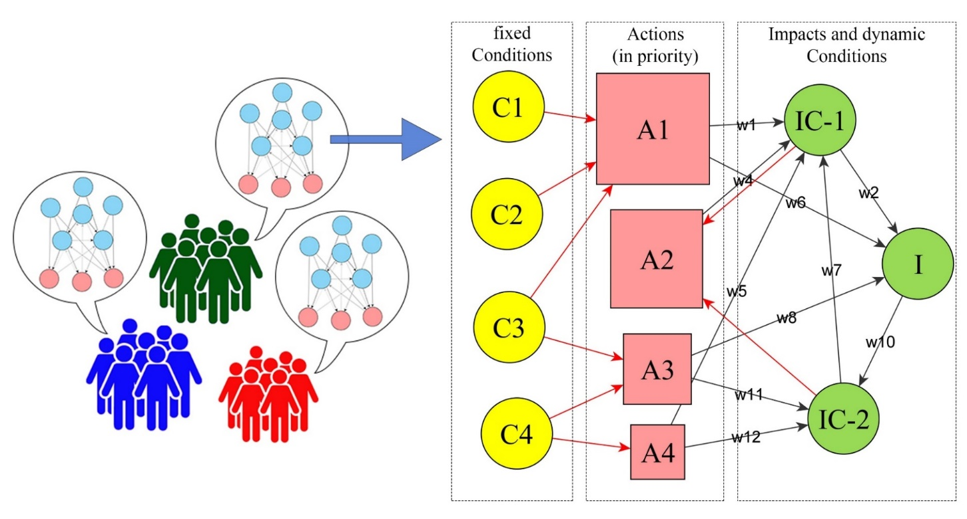
Using FCMs to develop behavioral rules
Small, Medium and Large farmers
Actions-conditions-impacts concepts
Driving-Impact connections

Slide 23
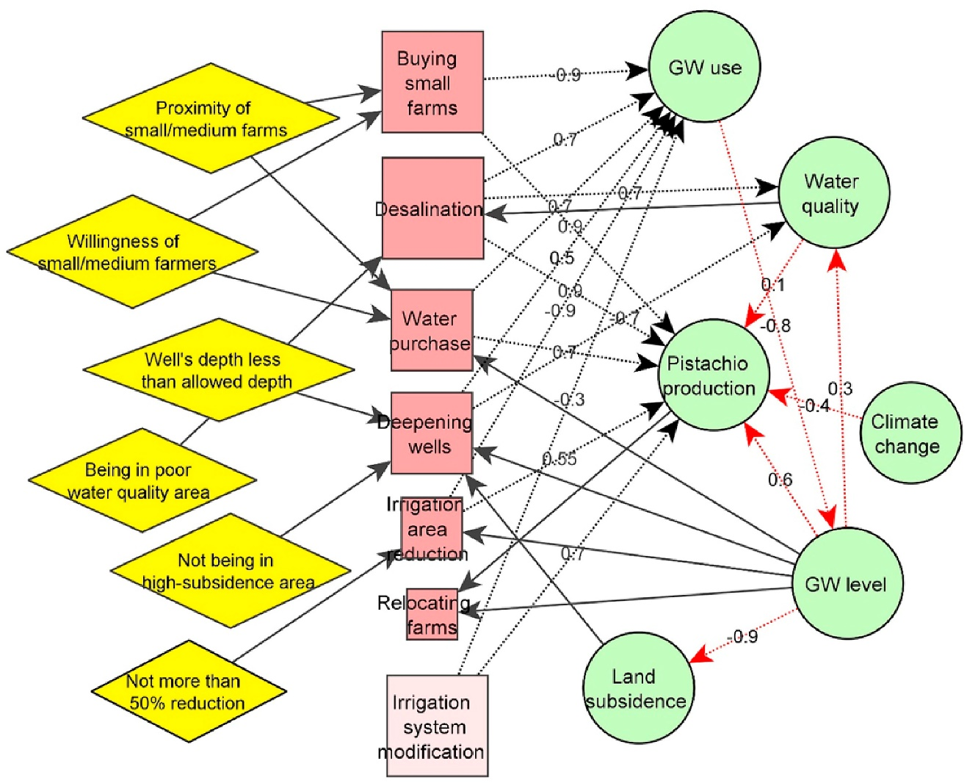
Using FCMs to develop behavioral rules
Condition-action-impact map of large farmers

Slide 24
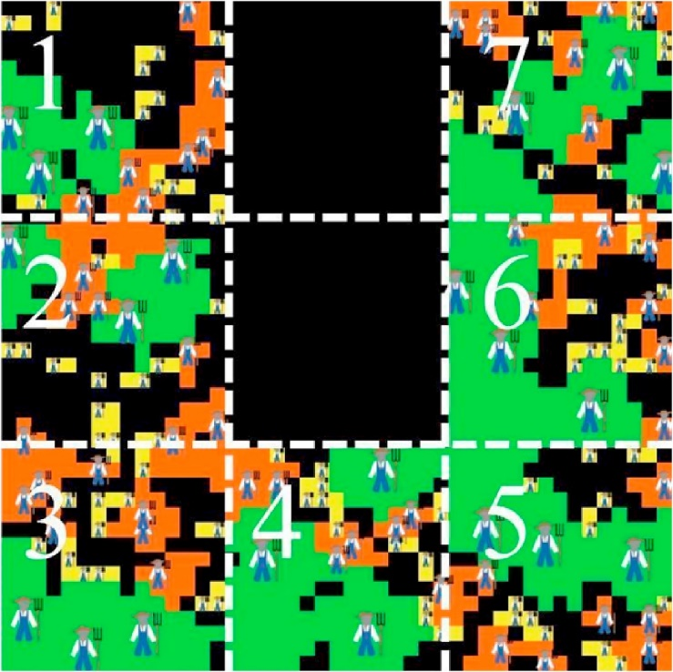
Using FCMs to develop behavioral rules
Adding randomness, time scale and spatial dimensions

Slide 25
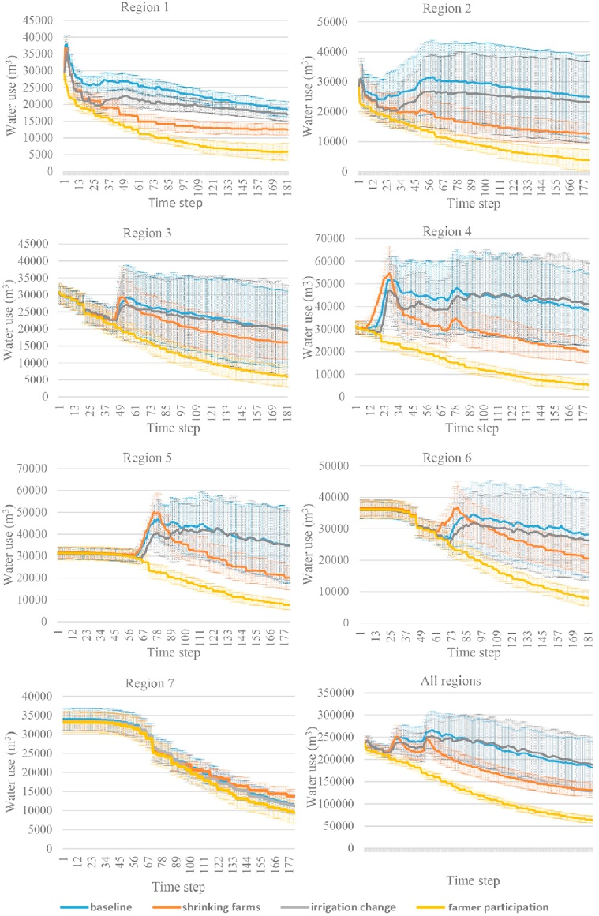
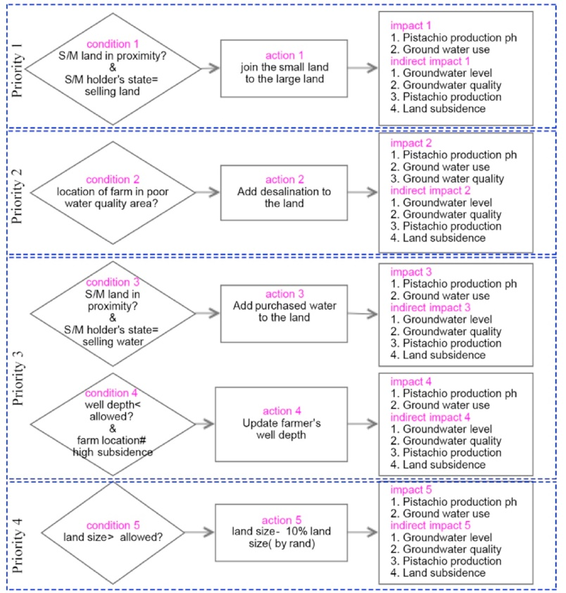
Using FCMs to develop behavioral rules
Condition-Action-Impact of large farmers

Slide 26
Challenges/ areas for improvement
More accurate models are needed to support decision-making in real world! Multi-disciplinary and integrated models
Mental models can only be used for understanding 1) different perceptions and perspectives, and b) experiences and decisions/actions in the past
Mental models does not provide accurate quantitative evidence
Important to think how much we can rely on people’s perceptions for identifying human behavior. Can we rely on what people think/describe they (would) do is specific situations?

Slide 27
Thank you!
email: s.mehryar@lse.ac.uk
Papers:
https://www.sciencedirect.com/science/article/pii/S0301479717303584
https://www.sciencedirect.com/science/article/pii/S0301479719312009
PhD thesis:
https://research.utwente.nl/en/publications/participatory-policy-analysis-in-climate-change-adaptation-from-i

