Slide 1

A Modelling Strategy for Living with Deep Uncertainty:
Towards an Open, Contingent, Adaptive and Reactive Resilience (OCARR)
Bruce Edmonds
and Vahid Yazdanpanah
Slides and paper available at: http://cfpm.org/ocarr

Slide 2
“The truth is that we are just not very good at forecasting the character of the risks that we will encounter.”
– Oliver Letwin,
UK Minister for Preparedness, 2010-16
(BBC, Radio 4, 16 March 2021)

Slide 3
Preparing for the future
Traditional planning assumes policy outcomes can be anticipated and compared
Being adaptive (learning from policy evaluation) relies on patterns being repeated
The participatory approach is useful when there are multiple viewpoints
Contingency planning relies on there being identified threats but not too many of them
But these do not cover all kinds of situation…

Slide 4
So what do we do when…
the impacts of policies are not predictable
there are too many possibilities to put in place contingency resources
we can’t assign possibilities meaningful probabilities
future events may not repeat past patterns
and it is politically unacceptable to adopt a ‘do nothing’ approach?
In other words, how might we survive conditions of deep uncertainty?

Slide 5
For this kinds of situation use the ‘OCARR’ approach:
Identify as many possible future trajectories as one can, from as many sources, regardless of their perceived likelihood.
Analyse the trajectories that would pose a significant threat – understanding how they might come about and develop.
Implement “early warning indicators” when these might be emerging at an early stage, to give policy makers the most time – enabling them to ‘drive’ the response better

Slide 6
The elements of OCARR are not new…
… the point is that now we have some of the tools that can make it more practical:
Agent-based models to uncover and understand complex possibilities – a more general class than “tipping points” than can integrate different ‘systems’
Participatory approaches that help map viewpoints and reconcile them
Machine learning analyses of data
Visualisation techniques of big data

Slide 7
Example: Fisheries Collapse
North Atlantic Cod
The Harris Commission said that modellers “…failed to recognize the statistical inadequacies in their bulk biomass model…” and that they had concerns that “…weaknesses in scientific management and the peer review process permitted this to happen.”
Models were simplistic
Focus of models had narrowed
Excluded input from fishers
Based on very ‘thin’ data

Slide 8
First, evolve a rich mixed ecology
Evolve plants then inject and evolve fish (first herbivores – later predators appear).
Result is a mature ecology with many species in a complex food web (left shows balance of tropic layers with log population scale)

Slide 9
Then explore starting from there
Do multiple runs of the simulation starting from there for each condition to test
Evolve a complex ecology and save this state
Each ecology evolved is not the ecology but a possible ecology, but it has the kind of complex interactions not present in simpler models

Slide 10
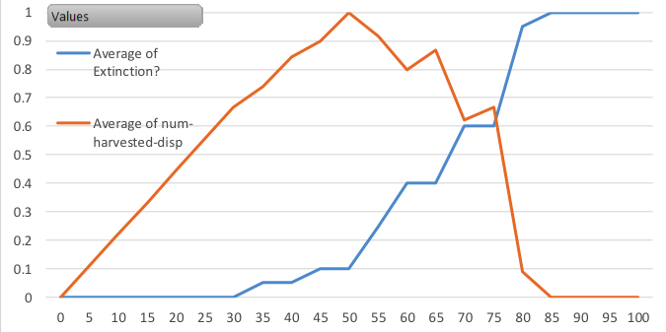
Total Extinction Prob. & Av. Total Harvest (last 100 ticks) for different catch levels
Proportion of Maximum
Catch level (per tick)

Slide 11
Num Fish (all species, 20 runs) – catch level 25 – each line is a different model run

Slide 12
Num Fish (all species, 20 runs) – catch level 35 – each line is a different model run

Slide 13
Average Number of Species, Catch=30

Slide 14
Average Number of Species, Catch=40

Slide 15
Conclusions
Agent-based modelling (ABM) can help in the identification and understanding of emergent processes – what could go surprisingly wrong
ABM allows for the:
Exploration of “messy” systems, beyond neat mathematical theory
Integration of very different aspects (social/economic/ecological/legal etc.)
Integration of stakeholder/qualitative knowledge
A possibilistic rather than probabilistic approach
Use with other tools (ML, participatory mapping etc.)

Slide 16




The End!
Scan the QR code to see the full paper
Slides and paper available at: http://cfpm.org/ocarr
Bruce: http://cfpm.org/~bruce
Vahid: https://www.ecs.soton.ac.uk/people/vy1y20

