Slide 1
Some Difficulties with Causation Bruce Edmonds

Slide 2
Why talk about causation
Ideas of causation or causal description lie behind both ABM and QCA
However, they have different versions:
In ABM it is programmed in and you see/analyse the effects of these
In QCA you get a logical description of the outcome in terms of the conditions
Usually a standard version of what is meant by causation is assumed, it “comes with” the tool
Here I look at the idea of causation and some of the variants/difficulties with it

Slide 3
A Causal Explanation is a Model
When we talk about “causation” we talk about properties of our model of reality
…it is not directly about reality itself
Though, in some circumstances, the model is so good it is safe to conflate the two
Here I look at some of the differences
Thus there are different versions of causation, and so different (causal) models of your model (of reality)

Slide 4
Why did Fred break his leg?
He was distracted and so tripped
He caught his foot on an uneven pavement
His bones were brittle due to a vitamin-D deficiency
Fred was clumsy due to stage of life
It was dark
Fred was not familiar with this route, because he was going to a job interview
Fred was short-sighted due to his genes
Etc. etc.

Slide 5
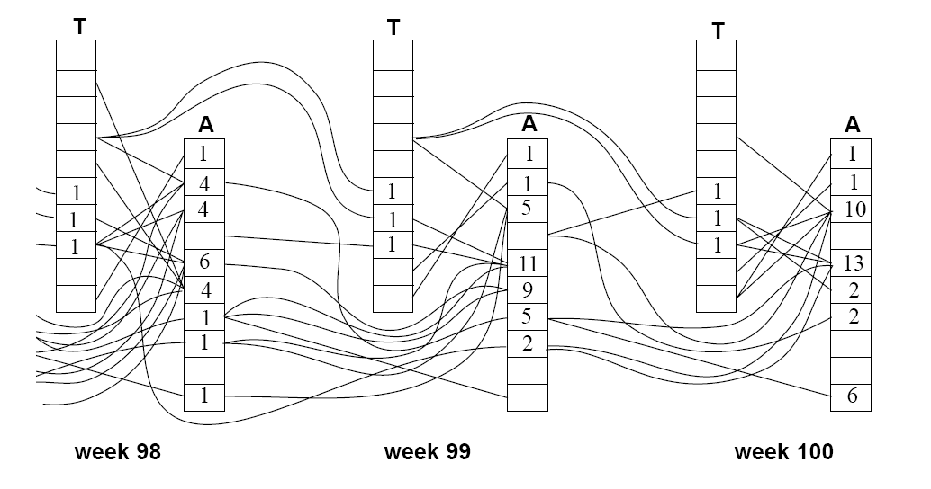
Causal Complexity in an ABM
Lines indicate causal link in behaviour over time, each box an agent’s talk or action decision (Edmonds 1999)

Slide 6
Causal Spread
Causal Spread (or “wild disjunction”) when there are an indefinite number of causal paths when you trace back from any event
Such a situation goes against the assumptions of most causal inference techniques, because they start with a finite number of possibilities
So what can one do?

Slide 7
A (simplistic) illustration of context from the point of view of an actor

Slide 8
The Context Heuristic
Divide the world into different sorts of situation (hereafter called a context)
Learn/recognise these contexts in a rich and “fuzzy” manner
“Crisp” knowledge is “packaged” “within” such contexts for reasoning, update etc.
Makes within-context reasoning, models, update etc. more feasible
Whilst each model has limited scope, together they might cover more ground, albeit in a more “patchy” manner
Notes:
warning about word context

Slide 9
Context and Causality
In almost all situations (and all social situations) there are an unlimited number of things that could be attributed as a cause
Without a limitation as to the scope causation makes no sense
However given a context there are many factors that can be assumed to be insignificantly relevant and/or constant – it reduces scope (but implicitly)
Causality makes sense given a context, since the context excludes most factors
Notes:
Example of someone who broke their leg for unlimited number of causes
in the broken leg example we can exclude that gravity was too strong
Formalisms such as Pearl are only applicable given a context

Slide 10
In ABM
One can only indirectly infer about causation (because this is what you put in)
Some implicit assumptions (due to context) become apparent during its construction
But contextual assumptions may limit comparison of results and data
Can explicitly trace ‘the cause’ of any event inside a simulation, but then this needs to be edited for relevance and comprehension
Understanding emergent causal pathways in simulation runs can be hard

Slide 11
In QCA
Directly infers a causal set description from reduced data
But framing (context) and interpretation needs care around the technique
Might miss an important condition in data which can make results misleading
Inference is clear and checkable
Resultant causal descriptions are essentially static

Slide 12
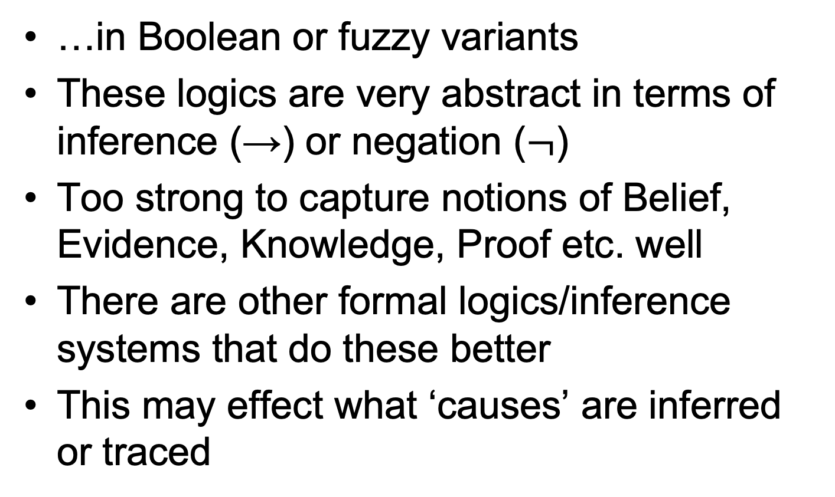
Both are based on classical logic…
…in Boolean or fuzzy variants
These logics are very abstract in terms of inference (→) or negation ($¬$)
Too strong to capture notions of Belief, Evidence, Knowledge, Proof etc. well
There are other formal logics/inference systems that do these better
This may effect what ‘causes’ are inferred or traced

Slide 13
Challenges from Context and Complexity
How can we actively combine/use tools such as ABM & QCA to…
To explore/map out/better document contextual limitations? (e.g. of data, assumptions, etc.)
How do we deal with complex systems with causal spread, without ‘hairball’ models (everything effects everything a bit in an undistinguished way)?

Slide 14
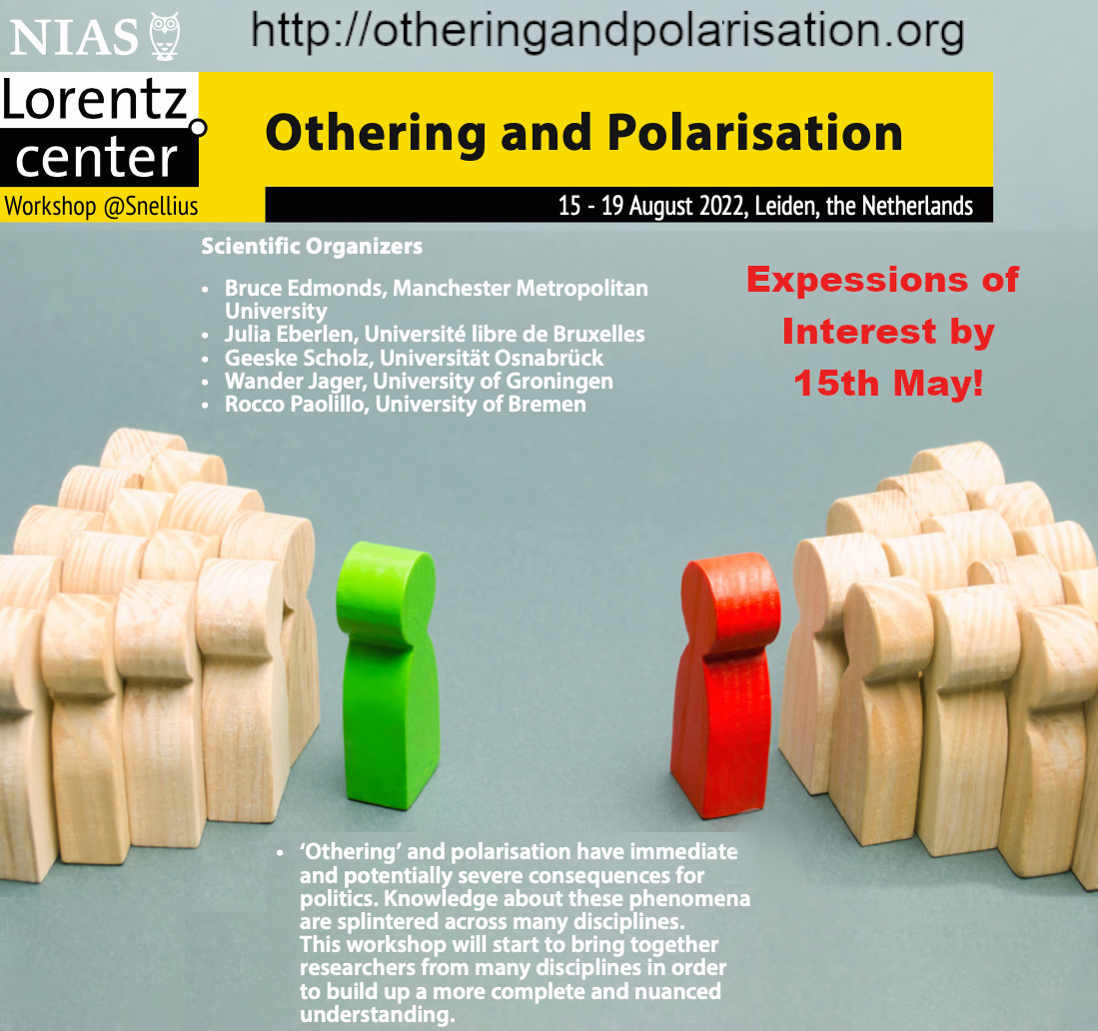
Thanks, here is a gratuitous ad →

