Slide 1
Simulation Case Studies
Mark Birkin

Slide 2
Complexity and the Economy
WB Arthur (1999), Complexity and the Economy, Science, 284, 107-109
W. Brian Arthur was born in 1945 in Belfast, Northern Ireland. He received his B. Sc. in Electrical Engineering at Queens University Belfast (1966), a M. A. in Operational Research (1967), at Lancaster University, Lancaster, England, and an M. A. in Mathematics at the University of Michigan (1969). Arthur received his Ph.D. in Operations Research (1973) and an M. A. in Economics (1973) from the University of California, Berkeley.
Arthur is the former Morrison Professor of Economics and Population Studies; Professor of Human Biology, Stanford University, 1983-1996.
Arthur is one of the distinguished External Research Faculty members at the Santa Fe Institute, Santa Fe, New Mexico, USA.

Slide 3
The El Farol Bar Problem
So this guy walks into a bar...
There is a particular, finite population of people. Every Thursday night, all of these people want to go to the El Farol Bar. However, the El Farol is quite small, and it's no fun to go there if it's too crowded. So much so, in fact, that the preferences of the population can be described as follows:
If less than 60% of the population go to the bar, they'll all have a better time than if they stayed at home.
If more than 60% of the population go to the bar, they'll all have a worse time than if they stayed at home.
Unfortunately, it is necessary for everyone to decide at the same time whether they will go to the bar or not. They cannot wait and see how many others go on a particular Thursday before deciding to go themselves on that Thursday.

Slide 4
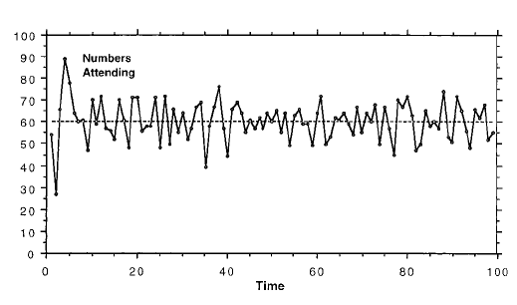
Bar Attendance in the first 100 weeks

Slide 5
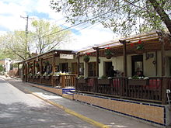

Slide 8
Why Is This Interesting?
An EQUILIBRIUM price is set through the ASYNCHRONOUS interaction between producers and consumers who are RATIONAL and PERFECTLY INFORMED

Slide 9
Why is this interesting?
There is no long-term EQUILIBRIUM; the future state of the ‘system’ depends on its current state (PATH DEPENDENCE); individual behaviour is based on imperfectly informed expectations about the behaviour of other agents (INTERDEPENDENCE)

Slide 10
This is a trivial example, but...
Arthur argues that the same is true of economic markets in general – how else to explain stock market bubbles, crashes, depression...?
Characterised by:
Multiple equilibria, nonpredictability, lock-in, inefficiency, historical path dependence, and asymmetry
Applications to: market allocation theory, international trade theory, the evolution of technology choice, economic geography, and the evolution of patterns of poverty and segregation.

Slide 11
“ The common finding that economic structures can crystallize around small events and lock in is beginning to change policy in all of these areas toward an awareness that governments should avoid both extremes of coercing a desired outcome and keeping strict hands off, and instead seek to push the system gently toward favoured structures that can grow and emerge naturally. Not a heavy hand, not an invisible hand, but a nudging hand. “

Slide 13
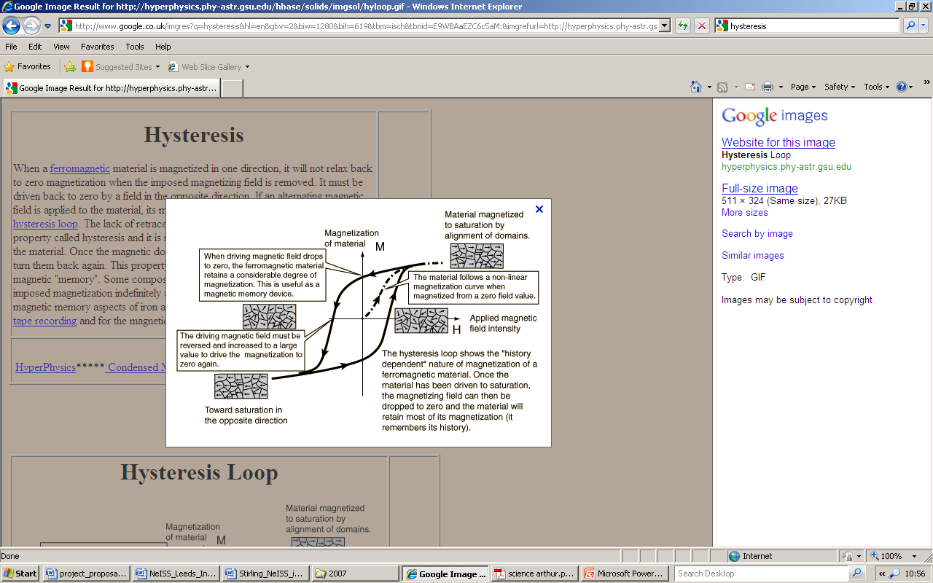

Slide 14
Ferguson, N. M., Cummings, A. T., Cauchemez, S., Fraser, C., Riley, S., Meeyai, A., Iamsirithaworn, S. & Burke, D. (2005). Strategies for containing an emerging influenza pandemic in Southeast Asia. Nature, 437(7056), 209–214.

Slide 15
Context and Objectives
Here we use a simulation model of influenza transmission in Southeast Asia to evaluate the potential effectiveness of targeted mass prophylactic use of antiviral drugs as a containment strategy. Other interventions aimed at reducing population contact rates are also examined as reinforcements to an antiviral-based containment policy. We show that elimination of a nascent pandemic may be feasible using a combination of geographically targeted prophylaxis and social distancing measures, if the basic reproduction number of the new virus is below 1.8. We predict that a stockpile of 3 million courses of antiviral drugs should be sufficient for elimination. Policy effectiveness depends critically on how quickly clinical cases are diagnosed and the speed with which antiviral drugs can be distributed.

Slide 16
Containment and Policy
Basic Reproduction Number (R₀) – the average number of cases generated by an infected individual
R₀ > 1 Contagion
R₀ < 1 Containment
Hence policy objective: how can the reproduction number be reduced through intervention?

Slide 17
Reduce contact rates
Immunise the target
Quarantine the carrier

Slide 18
Methods – Demographic Data
The model used Landscan data to generate a simulated population realistically distributed across geographic space. Thai census data on household size and age distributions were used for demographic parameterization.
Data from the Thai National Statistical Office were used to determine the number and proportions of children in school as a function of age, and data from the Thai Department of Education on 24,000 Schools were used to determine the distribution of school sizes.
Data on travel distances within Thailand were limited; here we used data collected in the 1994 National Migration Survey on distances travelled to work to estimate movement kernel parameters. The best-fit kernel had asymptotic power-law form as a function of distance d given by f (d) ~ 1/[ (1+(d/a)^{b} ] where a = 4 km and b = 3.8.
Thai workplace sizes also follow a power-law distribution, with an estimated maximum single workplace size of approximately 2,300 and a mean of 21 individuals.

Slide 19
Methods – Disease & Transmission Data
We used parameter estimates for current human influenza subtypes, and used sensitivity analyses to investigate what effect deviation from these estimates would have on policy effectiveness. The mean & s.d. of the incubation period distribution was estimated as 1.48 +- 0.47 days, on the basis of data from a multiple exposure event occurring on an aeroplane(!)
The model is a stochastic, spatially structured, individual based discrete time simulation. Individuals are co-located in households, with households being constructed to reflect typical generational structure while matching empirical distributions of age structure and household size for Thailand. Households are randomly distributed in the modelled geographic region, with a local density determined by the Landscan data.
We partition non-household transmission to give levels of within-place transmission comparable with household transmission and to qualitatively match 1957 influenza pandemic age-specific attack rates (!).

Slide 20
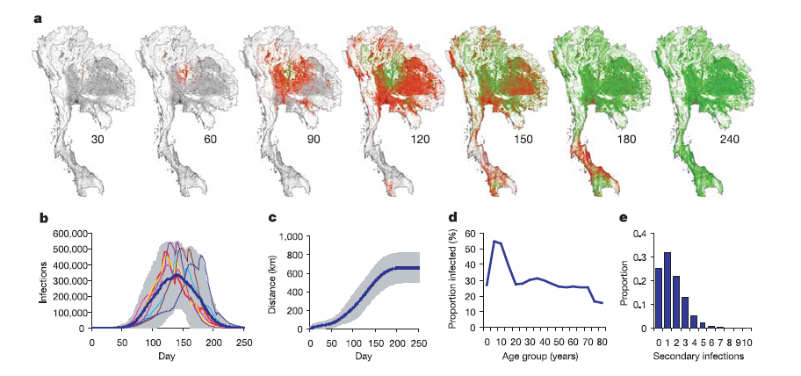
Spread of the epidemic from one rural individual; R₀ = 1.5

Slide 21
Prophylaxis Strategies
Blanket immunisation for a population of 85 million is not feasible
Social targeting – individuals in same household/ workplace/ school...
Depends on rapid detection and intervention
Not sufficient under normal conditions
Geographic targeting
Radial (increased effectiveness up to 10km)
Nearest m people

Slide 22
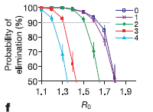
Prophylaxis Strategies
Effectiveness of geographical targeting
Speed of detection

Slide 23
Social Policies
“Predicting the effect of policies such as closing schools and workplaces is difficult”
Displacement?
Spontaneous change in contact rates?
School and workplace closure a valuable adjunct to immunisation
Quarantine zones also a useful option
“The only scenario under which purely socially targeted strategies might be sufficient would be if viral transmissibility evolved incrementally”

Slide 24
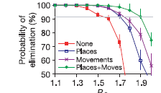
Social Policies

Slide 25
Conclusions (1)
Success criteria
rapid identification of cases, especially the original cluster
rapid delivery of treatment to targeted groups
effective delivery of treatment to a high proportion of the targeted population
sufficient stockpiles of drug (3 million+)
population cooperation with the containment strategy
international cooperation in policy development, epidemic surveillance and control strategy implementation.
Containment is unlikely if R₀ exceeds 1.8 for the new pandemic strain.

Slide 26
Conclusions (2)
The mathematical model we have used to examine the feasibility of pandemic containment is perhaps the largest-scale detailed epidemic micro-simulation yet developed.
A key goal of the modelling was parsimony. Although the representation of the population is detailed, this detail is underpinned by available demographic data.
The natural history parameters used here have been estimated from primary data on existing influenza strains. The model has five key transmission parameters, of which two were estimated from household data and the remaining three were qualitatively calibrated to historical age-dependent attack rates.
We believe that this type of simulation will increasingly become a standard tool for preparedness planning and modelling of new disease outbreaks.

Slide 27
Conclusions (3)
Large-scale and policy-oriented rather than pedagogic and abstract
Would you trust the deployment of 3 million drug treatments to this technology?
Is there a difference between
‘agent-based modelling’
‘discrete event simulation’
‘microsimulation’

Slide 28
S. Brailsford & B. Schmidt (2003) Towards incorporating human behaviour in models of health care systems: An approach using discrete event simulation, European Journal of Operational Research 150 (2003) 19–31

Slide 29
Context
Operational Research models in the field of health care often involve parameters which depend on the behaviour of human beings.
Epidemic models of the spread of HIV/AIDS depend not only on biological and physiological factors, but also on behavioural factors such as condom use, number of sexual partners and needle- sharing
Models for the prevention and treatment of heart disease need to account for variation in smoking, exercise, and dietary habits
Models to evaluate screening programmes for the early detection of disease must include a factor for patients compliance (the proportion of patients who attend each screen).

Slide 30
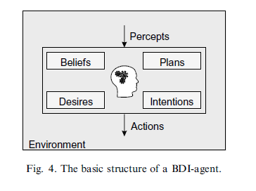
Beliefs, Desires, Intentions...
The fundamental shortcoming of the BDI architecture is the fact that it is restricted to cognitive processes. The integration of physical, emotional or social processes and their interactions are not taken into account.
The BDI architecture is valuable for technical applications like robotics. However, it is unsuitable for the modelling of human behaviour.

Slide 31
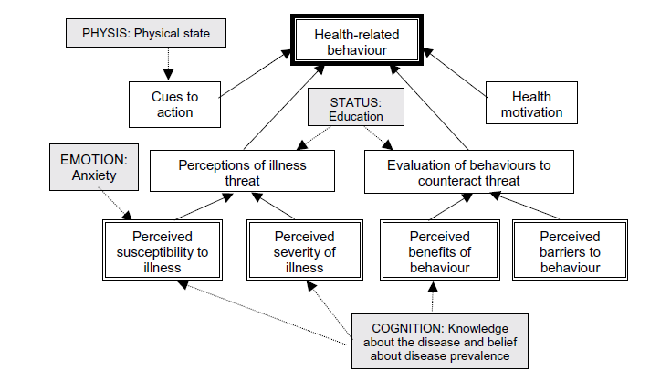
Physics, Emotion, Cognition, Status
A reference model which aims to be applicable to any problem
Combines cognitive with physical and emotional states, but also sociological factors, such as the importance of social norms, adaptation to group behaviour, compliance with social expectations, and the need for social contact

Slide 32
PECS Elements
PECS components for diabetic retinopathy:
• Physis: the physical state––the stage of retinopathy may affect people’s attendance; ( e.g. early diagnosis as a cue to action)
• Emotion: Anxiety, and individual perceptions of the overall threat of blindness, will together influence a person’s perceived susceptibility to becoming blind themselves. (e.g. anxious people may be more likely to attend for screening).
• Cognition: Knowledge about the facts of diabetic retinopathy, screening and treatment will influence a person’s perceptions about the severity of the disease and his/her evaluation of the benefits of screening to counteract the threat of blindness. A person’s belief about the prevalence of retinopathy could also affect their understanding of their own risk of getting it.
• Status: a person’s educational level is likely to determine his/her ability to evaluate behaviours to counteract the threat of blindness, and also his/her perceptions of the threat itself.

Slide 33
PECS Implementation
• Physis = stage of retinopathy = 0.7 for None, 0.9 for BDR or DMO, and 1.0 for all other states, reflecting our assumption that people with background retinopathy are aware they have potential sight problems and are thus more likely to attend for screening.
• Emotion = anxiety x perceived susceptibility where both take one of the three values 0.8 (low), 0.95 (medium), 1.0 (high).
• Cognition = knowledge of disease x belief about disease prevalence where both take one of the three values 0.8 (low), 0.9 (medium), 1.0 (high).
• Status = educational level takes one of the three values 0.8 (low), 0.95 (medium), 1.0 (high).

Slide 34
PECS - Simulation

Slide 35
Conclusions
The results showed the possibility of capturing the determinants of health behaviour sufficiently accurately to enable policy decisions aimed at increasing compliance to be made. (The standard method is simply to assume a certain (fixed) percentage of the population will fail to attend when invited for screening.)
The key benefit of this approach will be that it will enable health planners and policy-makers to design more efficient and effective screening programmes, in order to attract non-attenders and improve the overall health of the population.
The ability of agent-based simulation to model systems of patients in a more sophisticated way, incorporating not only their interactions with each other, but also with health care professionals and with the environment, gives rise to exciting prospects. This approach has the potential to be applied not just to screening for diabetic retinopathy, but to many other (health) arenas.
Further empirical work is required, firstly to derive and validate more realistic forms of the model equations, secondly to select the appropriate psychological variables, and thirdly and inevitably to collect data.

Slide 36
Using Simulation in Your Research
What do you hope to gain or learn from the simulation? Is this something you know or suspect already? Is this a specific problem that needs addressing? Could you achieve the same without a simulation?
How do I represent the agents in this system?
- What are their characteristics?
- How do they behave?
o Interactions between agents
o Interactions with the environment
- What is ‘the environment’ i.e. what features are internal to the model, and which are external?
How does the model treat time?
Real time?
Short time steps (minute; hour?)
Long time steps (day; month; year?)
Artificial time steps (e.g. interest is evolution of system towards equilibrium or steady state)
What kinds of data might be available to initiate the model? Is there any useful way in which outputs from the simulation could be compared to observations/data/evidence from what you are simulating?
How should the success (or otherwise) of the simulation be judged?
Are the results of the simulation useful to others (or only you)? If so in what way?

