Slide 1
A Look Inside Some NetLogo Simulations
Bruce Edmonds Centre for Policy Modelling Manchester Metropolitan University
Notes:
Introduce me and the CPM
Complexity Group and Grant Proposal with ISC

Slide 2
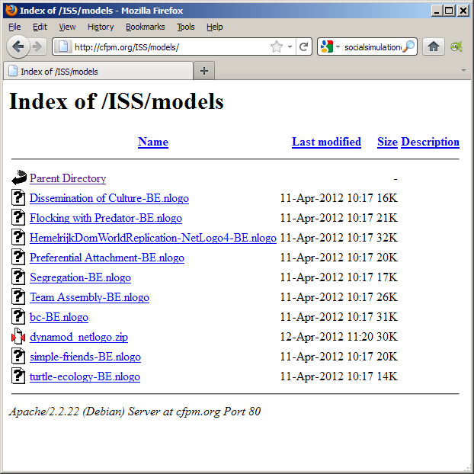
Opening the model
http://cfpm.org/ISS/models
Click on this one and open

Slide 3
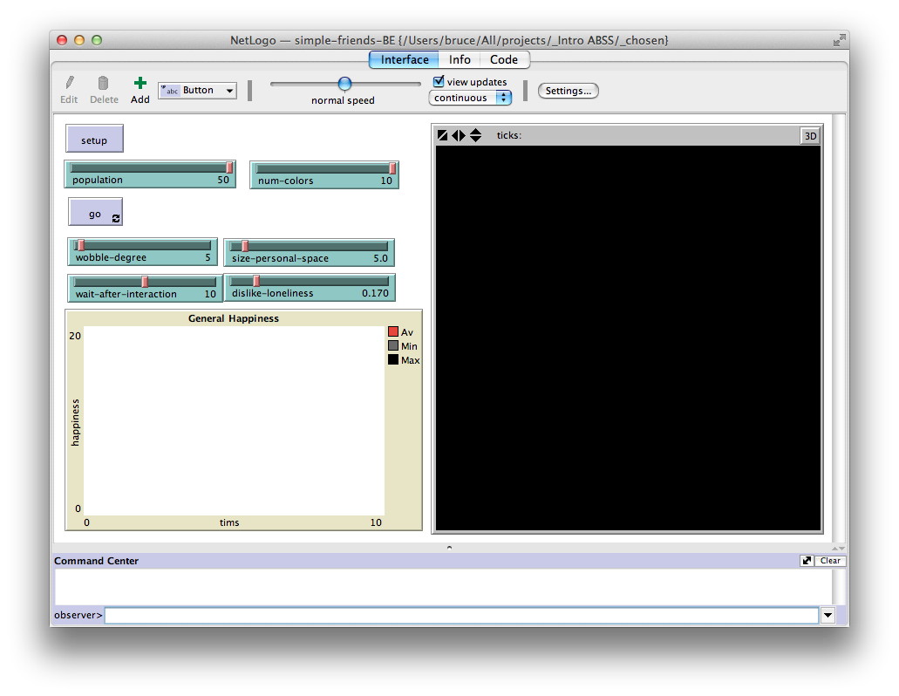
Swap between pages
Command Buttons
Parameters/settings
View of World
Place to type commands

Slide 4
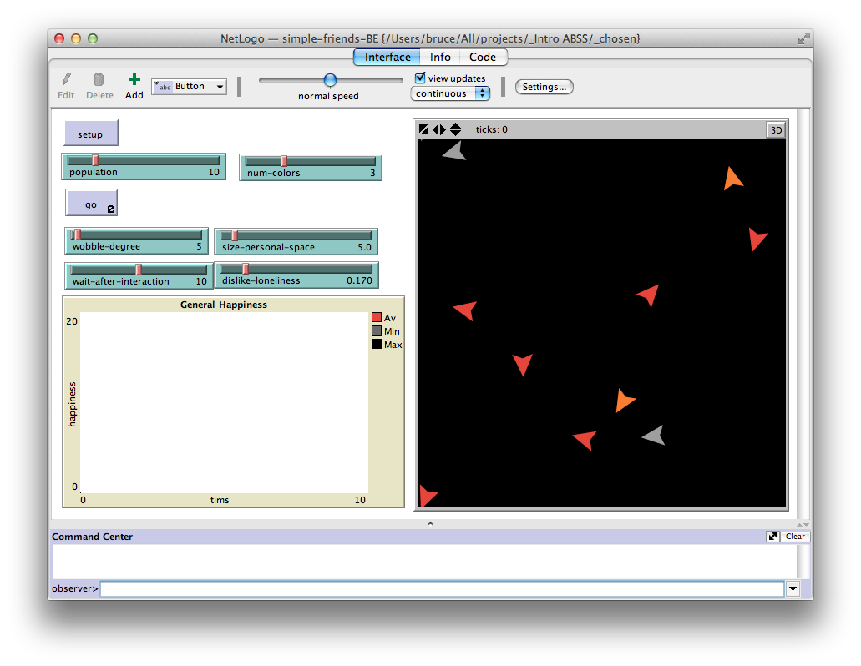
Setup button initialises the simulation
Agents pictured in the world

Slide 5
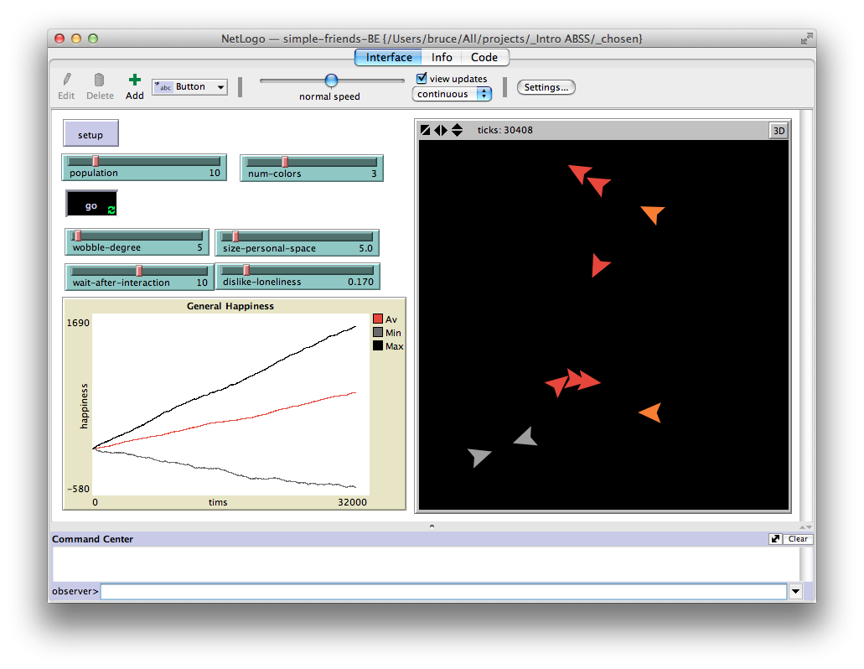
Adjust Speed
Pressing the “go” button turns the simulation on and off
Data from graphs can be output to a file for further analysis

Slide 6
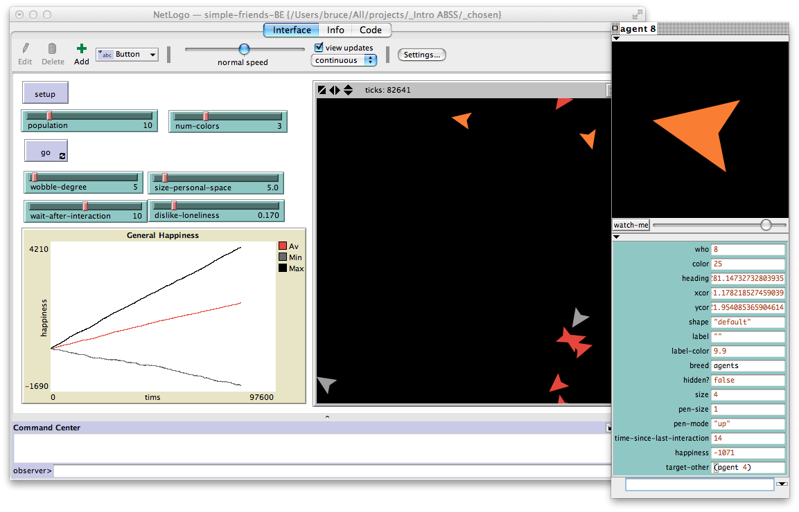
If you “right click” on an agent it shows you its state
Click on top left square to close

Slide 7
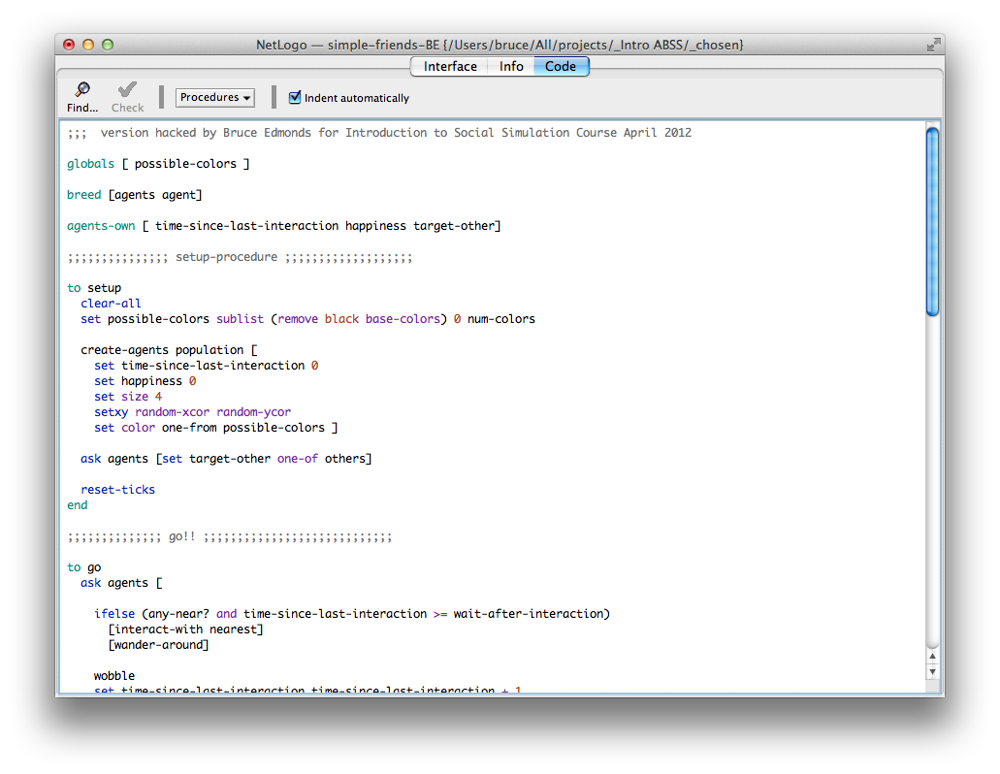
The Code Page
Get here by clicking here
General declarations and comments
The programme is a series of commands in the NetLogo Syntax
“setup” procedure has commands to initialise simulation
“go” procedure has commands of what to repeatedly do when go button is pressed

Slide 8
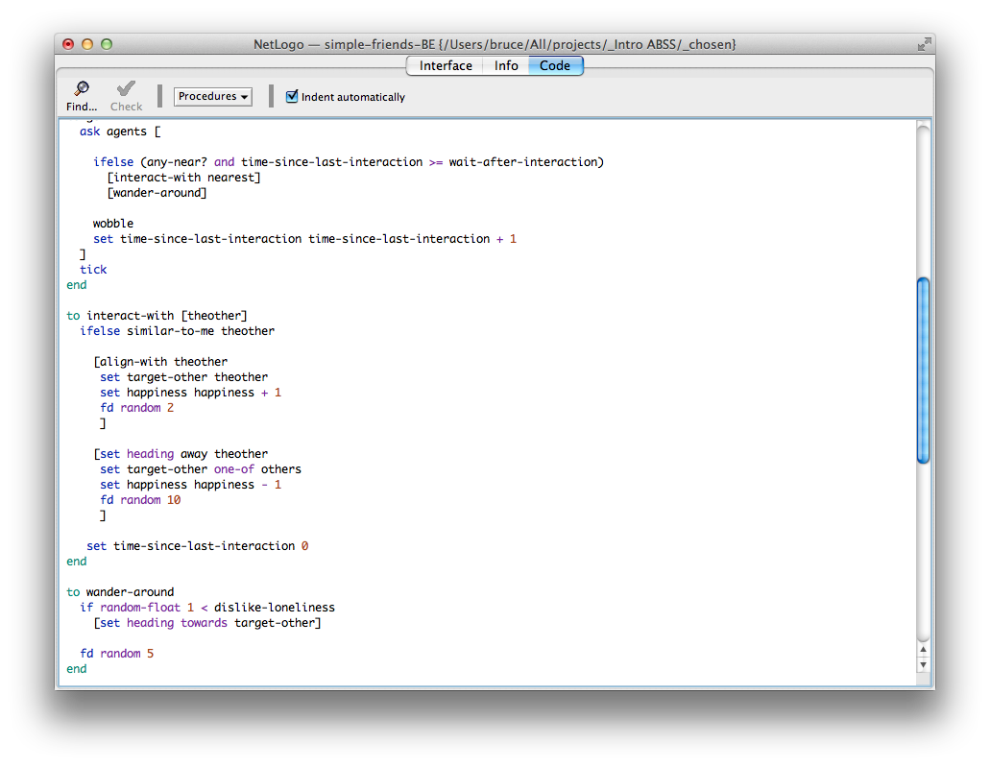
Says tell each agent to do the following: IF there are others near etc. THEN interact with nearest OTHERWISE wander around
Defines what “interact with” means, namely: IF this other is similar to myself
THEN align direction with them, adopt as my target, and add to my happiness, and move forward OTHERWISE face the opposite direction to them, adopt a random other as my target, reduce happiness and move forward a larger amount
Defines what “wander around” means, namely: IF a random number is < the dislike-loneliness parameter THEN face towards one’s adopted target
After this move forward

Slide 9
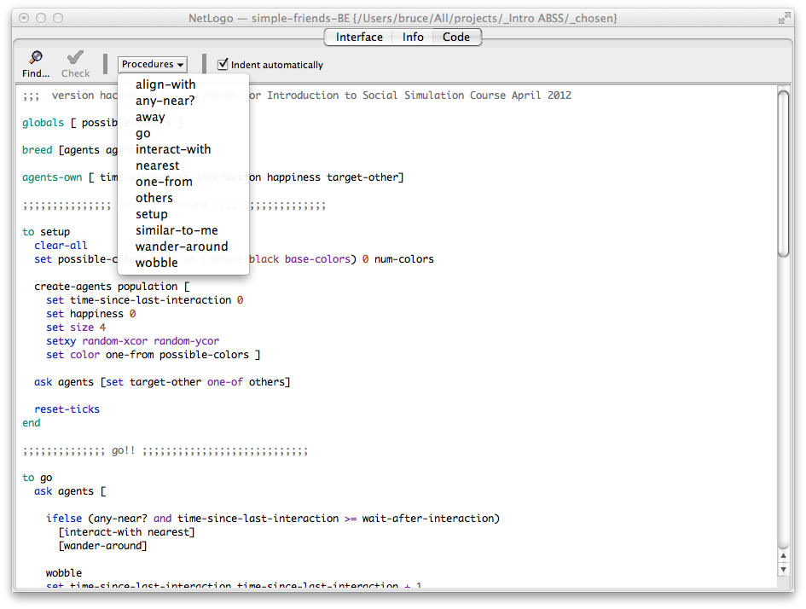
Programme Code in NetLogo
This button shows a list of all user defined commands
Netlogo code is divided into procedures marked by “to” and “end”
They each define a new NetLogo command of your own invention in terms of other Netlogo commands
You can then use that new word yourself in other procedures etc.

Slide 10
Help >> NetLogo User Manual
Contents
Most Useful Page!

Slide 11
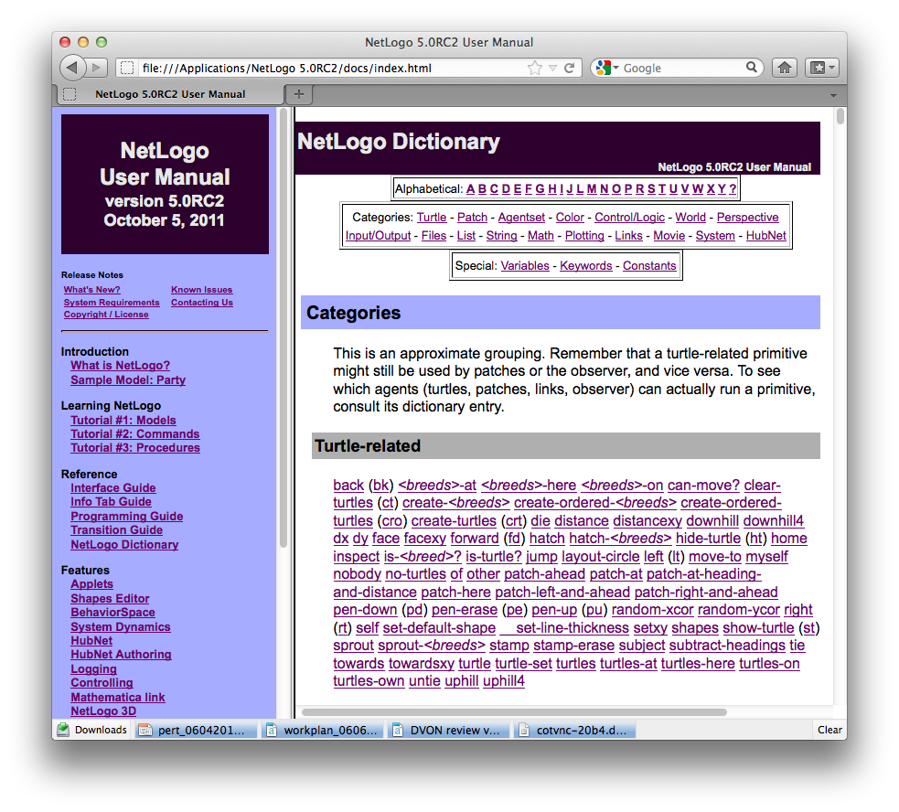
NetLogo Dictionary
Indexes
These are all the commands that come built into NetLogo for you to use in the definition of your own commands and code
Click on these to get to individual entries

Slide 12
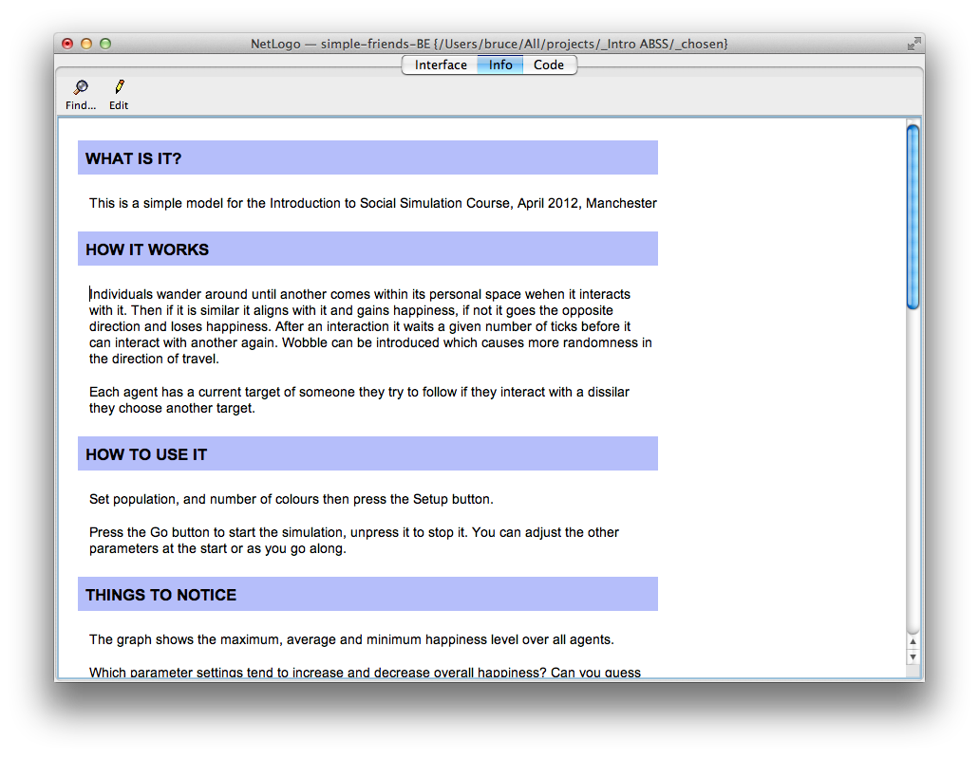
Netlogo Information Page
Middle button for the information page

Slide 13
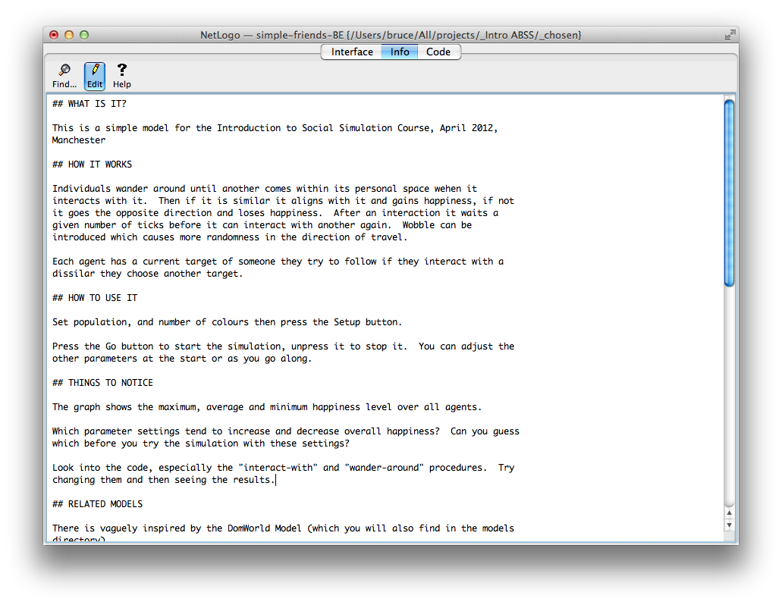
This button toggles the view of the information page so you can edit the text there.

Slide 14
Try changing the code… e.g….
Move where wobble happens Swap around interact.. and wander… Change the ifelse condition
Add in extra commands
Change the if condition here
Change the commands in the first set of brackets
Maybe change which target is chosen
Change what happens if they are not similar
Change how much they move and how
Change what happens if and when they wander around
Whether their wandering has a goal

Slide 15
Now try playing with some others
http://cfpm.org/ISS/models
1. A fun flocking model
2. A network model of web links forming etc.
3. The Schelling Segregation Model

Slide 16
The End
Introduction to Social Simulation Course Page
https://sites.google.com/site/socialsimulationcourse
Bruce Edmonds
http://bruce.edmonds.name
Centre for Policy Modelling
http://cfpm.org
Manchester Metropolitan Business School
http://www.business.mmu.ac.uk
NeISS Portal
http://www.neiss.org.uk

