Slide 1
Checking and understanding Simulation Behaviour
Bruce Edmonds Centre for Policy Modelling Manchester Metropolitan University
Notes:
Introduce me and the CPM
Complexity Group and Grant Proposal with ISC

Slide 2
Verification and Validation
Validation
Verification

Slide 3
Case Study 1: Where the authors did not understand their own code!

Slide 4
A Brief History
Idea of tags comes from (Holland 1993)
(Riolo at al. 2001) publish a simple model in Nature purporting to show evolution of cooperation without reciprocity
Praised by eminent academics (Sigmund and Nowak 2001)
Turns out model was extremely brittle (Roberts and Sherratt 2002)
Double replication and analysis reveals original results due to a process not understood by original authors (Edmonds and Hales 2003)

Slide 5
Basic Idea
A population of agents, each with a “tag” (a value in [0, 1]) and a tolerance
Each iteration agents randomly paired
If other’s tag is within the tolerance of an agent’s tag (i.e. its close enough) it donates to that other
Donating costs the donor – it gets no direct benefit
Agents with more value are preferentially reproduced
And yet those that donate seem to thrive, forming an apparently cooperative group

Slide 6
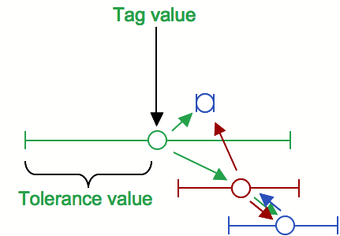
Illustration of tag mechanism
Donation occurs if: | mytag – otherstag | ≤ mytolerance

Slide 7
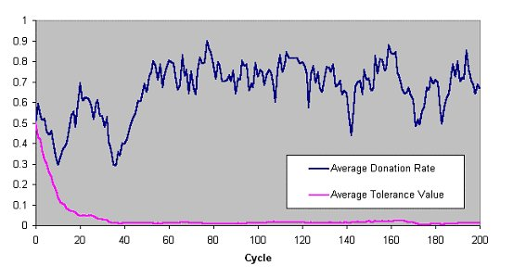
Their Results and Conclusion
Strategies of donating to others who have sufficiently similar heritable tags ... can establish cooperation without reciprocity. (Riolo et al. 2001, page 443)

Slide 8
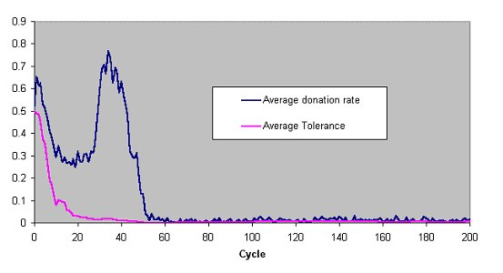
However…
…if donation criteria is changed to:
| mytag – otherstag | < mytolerance

Slide 9
Further investigation showed…
That the reported effect depended upon the donation of individuals with identical tags
With the original donation criteria agents are ‘forced’ to donate (i.e. they do even with zero tolerance) if the criteria is changed, so that agents can evolve/‘choose’ to be completely selfish cooperation disappears
Tolerance in model turns out to only be important as a symmetry-breaking mechanism given the (slightly odd and non-standard) selection mechanisms used in the original
Though tag-based cooperation can be made to work without ‘forcing’ it (Edmonds 2006)

Slide 10
Conclusions changed…
From:
Strategies of donating to others who have sufficiently similar heritable tags ... can establish cooperation without reciprocity
To:
Compulsory donation to others who have identical heritable tags can establish cooperation without reciprocity in situations where a group of tag clones can replicate themselves exactly

Slide 11
What went wrong?
The authors clearly did not understand their own model and how and why it worked
I suspect…
They only tried a few variations of their model
They only looked at their results using aggregate outcome measures & graphs
They did not test their hypotheses about what was happening using simulation experiments
No one else had inspected and replicated it
The over-interpreted their model
They rushed to print

Slide 12
References
Holland, J. (1993) The Effect of Labels (Tags) on Social Interactions. SFI Working Paper 93 10 064. Santa Fe Institute, Santa Fe, NM, USA.
Riolo, R. L., Cohen, M. D. and Axelrod, R. (2001) Evolution of cooperation without reciprocity. Nature, 411:441-443.
A reproduction of the (Riolo et al 2001) model including the modifications described in (Edmonds & Hales 2003) is: http://cfpm.org/ISS/models/Riolo model.nlogo
Sigmund, K. and Nowak, M. A. (2001) Evolution - Tides of tolerance. Nature 414:403.
Roberts, G. and Sherratt, T. (2002) Does similarity breed cooperation? Nature 418:499-500.
Edmonds, B. and Hales, D. (2003) Replication, Replication and Replication - Some Hard Lessons from Model Alignment. Journal of Artificial Societies and Social Simulation 6(4):11. http://jasss.soc.surrey.ac.uk/6/4/11.html
Edmonds, B. (2006) The Emergence of Symbiotic Groups Resulting From Skill-Differentiation and Tags. Journal of Artificial Societies and Social Simulation, 9(1):10. http://jasss.soc.surrey.ac.uk/9/1/10.html
A version of the model described in (Edmonds 2006) is: http://cfpm.org/ISS/models/Evolution of Symbiosis.nlogo

Slide 13
A Brief Analysis of the Stages in the Development of Simulations and Some Suggestions about Checking Them

Slide 14
The Difficulties in Verification
Simulation code is alien and unnatural!
Simulation code is complicated and its easy to make mistakes
Simulation outcomes are not always easy to understand from its set-up (emmergence)
You might have multiple goals for a simulation
You might not have enough time to really understand your own simulation
There might be an intermediary between you and the simulation (e.g. a programmer)
There are, actually, lots of different representations of the simulation in use!

Slide 15
Some of the Different Representations of a Simulation
Your intention for the simulation
Your description of your design for a simulation
A specification of the simulation
The (current) simulation code
Your understanding of how the code works at the micro-level
The outcomes from running the simulation
Representations of the outcomes (stats, graphs, visualisations, traces etc.)
Your understanding of what emerges from the complex interactions within the simulation
Hypotheses about what happens in the simulation
Your interpretation of the outcomes and hypotheses in terms of the observed social phenomena

Slide 16
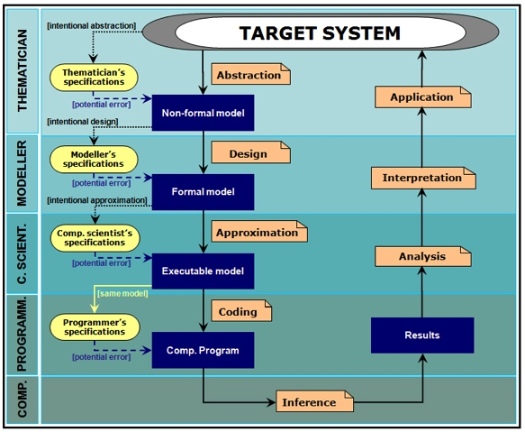
Possible Stages of Verification (from Galán et al. 2009 JASSS)
Theories
Application
Interpretation
Model
Analysis
Specification
Outcomes
Code

Slide 17
Model Checking Suggestions
Develop different models for the same theories/ideas
Explore the outcomes over the parameter space intended for the model
Try the model for well understood situations/settings
Check against mathematical abstractions
Visualise the processes in the model
Follow case studies of individual agents

Slide 18
Program Checking Suggestions
Try the simulation in different systems or using different languages/libraries
Try ‘turning off’ features and check the residual behaviour is as suggested
Check smaller chunks of the simulation that they are behaving as they should
Represent the code’s behaviour in as many different ways as possible
Build in internal checks, even if you don’t thing they are necessary

Slide 19
Community Strategies
Get outside expert opinion on the results coming from your model – are they reasonable?
Have others play with your simulation (make it available e.g. openabm.org)
If there is a programmer learn something about the program and get the programmer to learn about the domain area
Ultimately get someone else to independently replicate your simulation

Slide 20
References
Axtell, R., Axelrod R., J.M. Epstein and M.D. Cohen (1996), "Aligning Simulation Models: A Case Study and Results", Computational and Mathematical Organization Theory 1(2), pp. 123-141.
Galán, J. M. et al. (2009). 'Errors and Artefacts in Agent-Based Modelling'. Journal of Artificial Societies and Social Simulation 12(1)1. http://jasss.soc.surrey.ac.uk/12/1/1.html
Handbook of Simulating Social Complexity (soon, really!)

Slide 21
Case Study 2: Trying to understand and check a complex simulation

Slide 22
Trying to Check a Complex Simulation
A complex model that attempts to integrate as much of the evidence as possible within a coherent framework (a “Data Integration Model”)
Developed over time in close conjunction with domain experts
First version just reaching the validation stage
Intermediate programmer (me!) trying to incorporate design of experts

Slide 23
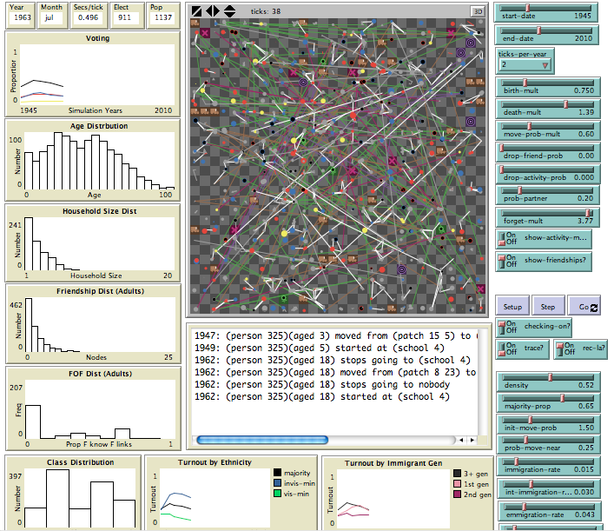
Different ways of checking
Visualisation of the detail
Lots of different views/graphs of what is happening
Built in checking
Different trace and tracking tools
Individual case story

Slide 24
Other steps taken to check code
Documenting the evidence, motivations and intentions of the model in detail
Rapid prototyping, showing early versions of the model and with frequent meetings discussing its implementation and behaviours
Multiple validation against many different criteria planned
Feedback from many others as to the specification and outcomes of the model
Checking the model against others (e.g. population models) planned

Slide 25
Conclusion: General Strategies
Be as clear and as specific about the various representations/goals as possible and document them!
Try to check things in lots of different ways
Look and check at various levels
Build checks into your procedures and code
Gold Standard: Independently replicated simulations

Slide 26
The End
Introduction to Social Simulation Course Page
http://sites.google.com/site/socialsimulationcourse
Bruce Edmonds
http://bruce.edmonds.name
Centre for Policy Modelling
http://cfpm.org
Manchester Metropolitan Business School
http://www.business.mmu.ac.uk
NeISS Portal
http://www.neiss.org.uk

