Slide 1
An Abstract Agent-based Simulation – the “relative agreement” opinion dynamics model
Bruce Edmonds Centre for Policy Modelling Manchester Metropolitan University
Notes:
Introduce me and the CPM
Complexity Group and Grant Proposal with ISC

Slide 2
A Brief Description of the Model
Deffuant, G., Amblard, F., Weisbuch, G. and Faure, T. (2002) How can extremism prevail? A study based on the relative agreement interaction model. Journal of Artificial Societies and Social Simulation 5(4):1. http://jasss.soc.surrey.ac.uk/5/4/1.html

Slide 3
A Bit of History
There is a long history of precursors:
‘Spin Glass’ models where everyone has opinion 0 or 1 and interact via a local ‘field’
Models with continuous opinions between 0 and 1 and random continuous interactions between agents
During EU funded IMAGES project, (modelling the diffusion of green practises in the European farming population), it was noticed that in meetings opinions often tended to become polarised around more extreme views as the meetings went on.
None of the previous models of interacting opinions showed this feature, so the authors made a new model that did exhibit this as emergent behaviour

Slide 4
The Model
A fixed population of agents, each with an ‘opinion’ (a value in [-1, 1]) and an ‘uncertainty’ (another value in [0, 1])
Most agents have random opinions and relatively high uncertainties to start with
A few agents have extreme opinions (1 or -1) and low uncertainty (e.g. 0.1)
Each iteration a pair of agents is randomly selected to interact: they influence each other’s opinions and uncertainties

Slide 5
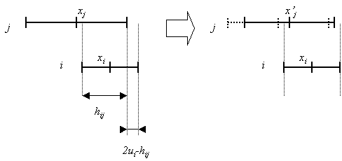
The mutual influence illustrated
i only influences j if its opinion lies within the uncertainty bounds around j’s opinion (left)
The relative agreement (ra_{ij}) is the (overlap – non-overlap) / own-uncertainty
i’s opinion (x_{i}) and uncertainty (u_{i}) are influenced in proportion to ra_{ij} (j’s influenced prop. to ra_{ji})

Slide 6
Result of this arrangement
The smaller the uncertainty the closer other agents have to be to influence it
AND the less effect they have upon their opinions and uncertainties
Moderates (with higher uncertainties) are influenced by more and are influenced more
This results in clusters of like-minded agents with the same opinion forming
Extremists tend to ‘drag’ the moderates to their opinion and reduce their uncertainty

Slide 7
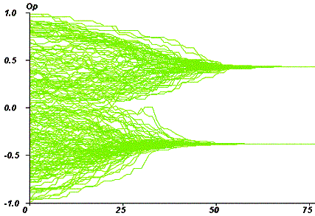
Outcomes with No Extremists

Slide 8
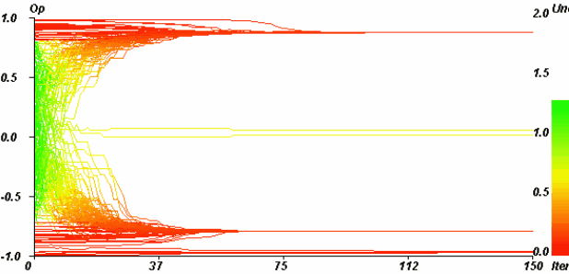
Outcomes with 10% Extremists

Slide 9
Look at model and the paper
Paper is at: http://jasss.soc.surrey.ac.uk/5/4/1.html
Model is at: http://cfpm.org/ISS/models
“simple opinion dynamics model.nlogo”
In paper and model:
N – number of agents
p_{e} – proportion of extremists
u – initial uncertainty of moderates
u_{e} – initial uncertainty of extremists

Slide 10
Tasks
Play with the model
See if you can get similar results as shown in the paper’s figures
Read the paper’s:
Introduction
Conclusions
The ways the model is checked and explored
Discuss the paper and the model in groups

Slide 11
Questions to Discuss
What are the goals of this model/paper?
Is it convincing?
What do you learn from playing with the model?
What do you learn from reading the paper?
How did they seek to check the model?
How did they seek to understand their model?
How does it inform our understanding of social phenomena?

Slide 12
References
Deffuant, G. 2001. Final report of project FAIR 3 CT 2092. Improving Agri-environmental Policies: A Simulation Approach to the Cognitive Properties of Farmers and Institutions. http://wwwlisc.clermont.cemagref.fr/ImagesProject/default.asp
Deffuant, G., Amblard, F., Weisbuch, G. and Faure, T. (2002) How can extremism prevail? A study based on the relative agreement interaction model. Journal of Artificial Societies and Social Simulation 5(4):1. http://jasss.soc.surrey.ac.uk/5/4/1.html
A simple version of this model is: http://cfpm.org/ISS/models/simple opinion dynamics model.nlogo
A more complex version that compares it with other and has more options is: http://cfpm.org/ISS/models/bc-BE.nlogo

Slide 13
The End
Introduction to Social Simulation Course Page
http://sites.google.com/site/socialsimulationcourse
Bruce Edmonds
http://bruce.edmonds.name
Centre for Policy Modelling
http://cfpm.org
Manchester Metropolitan Business School
http://www.business.mmu.ac.uk
NeISS Portal
http://www.neiss.org.uk

