Slide 1
Critically assessing and analysing simulation results
Bruce Edmonds Centre for Policy Modelling Manchester Metropolitan University
Notes:
Introduce me and the CPM
Complexity Group and Grant Proposal with ISC

Slide 2
Back to the simulation goal…
How you assess the results of a simulation depends on its goal, for example:
Predict in new circumstances
Explain how something might have come about
Establish the nature of a complex process
Test a hypothesis about a complex process
Uncover hidden assumptions
Integrate sets of evidence into a coherent framework
To be interesting to other academics (!?!)

Slide 3
Prediction (in the widest sense)
Is what is being predicted genuinely unknown when the model was made?
Which aspects are being predicted and which assumed to be simulation artifacts?
Under what conditions does the prediction work reliably? Are these conditions indicated?
How reliable/accurate are the predictions?
Is the reason why it predicts clear?
Have the predictions been done by different, independent teams?

Slide 4
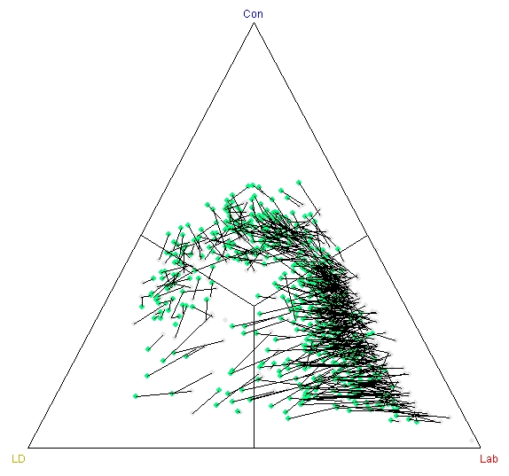
Example of Prediction
Prediction of final election result using exit poll data the previous day.
Genuine prediction, but with lots of data and a small time ahead
Predicts overall number of seats, not who wins individual seats.
Quite reliable
Conditions it works not known!
Reason it predicts is local consistency of response over electorate (?)
Curtice, J. & Firth, D. (2008) Exit polling in a cold climate: the BBC–ITV experience in Britain in 2005. Journal of the Royal Statistical Society: Series A (Statistics in Society), 171(3):509–539.
Brown, P. J., Firth, D. and Payne, C. D. (1999) Forecasting on British election night 1997. Journal of the Royal Statistical Society: Series A (Statistics in Society), 162(2):211-226.

Slide 5
Explanation
Exactly which aspects of data/evidence are being explained?
What sort of simulation process & setup establishes the candidate explanation?
Are aspects that are deemed essential to the explanation distinguished from the rest?
Is it experimentally shown that the essential is, in fact, necessary to result in the explained?
Are aspects deemed inessential varied to show the explained do not depend on them?
What other assumptions are necessary for the simulation to show this explanation? Are they plausible?
Would many different models explain the same things (but in different terms and in different ways)?

Slide 6
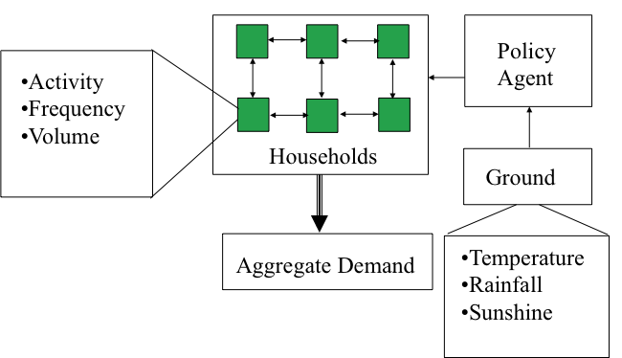
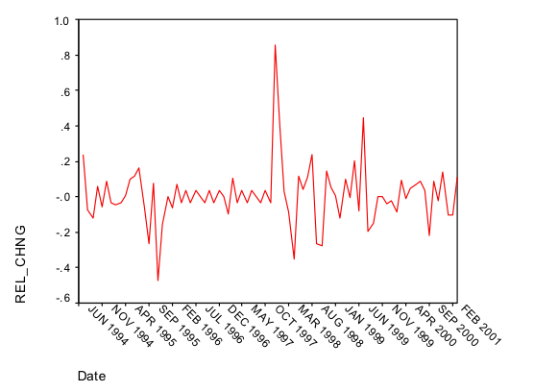
Example of Explanation
Model of Social Influence and Domestic Water Demand
Explains: clustered volatility and location-specific variation in terms of social influence
Data being explained is aggregate output data for localities
Some experiments to compare against scenarios with different climate input, innovation dates and randomisation of social network
Lots of other assumptions, e.g. social network structure, cognition of agents
(see slides on Complex ABSS slides for references)

Slide 7
Establishing the Nature of a Complex Process
How important is the process under study? How novel is it? How general is it?
Is this a variation of an already explored process or a new kind of process?
If a variation, does this address an important issue or assumption?
If new, what does this process do/show that others do not?
How thorough is the exploration?
Is the exploration limited to aggregate outcomes, or does it also delve into the micro?
Are there stated hypotheses about the nature and working of the process?

Slide 8
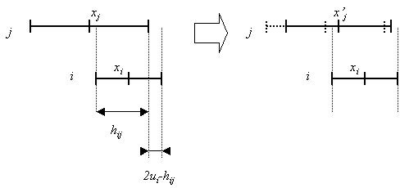
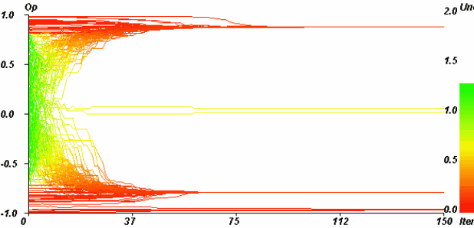
Example of Establishing Nature of a Complex Process
Opinion dynamics with moderates and extremists using relative agreement
Somewhat novel in that it shows the emergence of polarisation
Is a variation of existing models but shows an important new phenomena
Thorough exploration, both by parameter mapping, and mathematical analysis
Are explicit hypotheses
Deffuant, G., Amblard, F., Weisbuch, G. and Faure, T. (2002) How can extremism prevail? A study based on the relative agreement interaction model. Journal of Artificial Societies and Social Simulation 5(4):1. http://jasss.soc.surrey.ac.uk/5/4/1.html

Slide 9
Testing Hypotheses about a complex process
Are the hypotheses novel? Are they clearly defined? Are they important?
How clearly do the simulation experiments demonstrate (contradict) the hypotheses?
Do the experiments rule out all plausible competing explanations?
Is it clear what auxiliary assumptions are common to all variations tried?
Is the scope of the experimental testing clear?

Slide 10
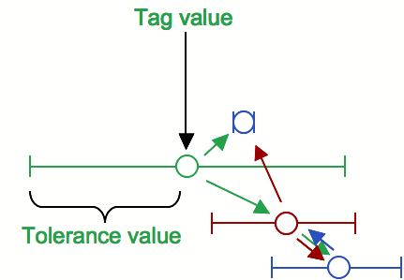
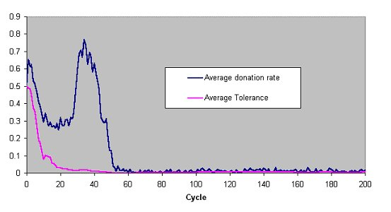
Example of Testing Hypotheses
Checking hypothesis about reasons for model results in Riolo et al. tag model
Original hypothesis was widely cited
Lots of replication and experiments to demonstrate how hypothesis were wrong
Auxiliary assumptions relatively drastic and partially discussed
Edmonds, B. and Hales, D. (2003) Replication, Replication and Replication - Some Hard Lessons from Model Alignment. Journal of Artificial Societies and Social Simulation 6(4):11.

Slide 11
Uncover Hidden Assumptions
Is it shown that researchers have, in fact, been making this assumption implicitly?
Does it show that this assumption makes a real difference in terms of results?
Does including this assumption change how we understand/explain things? Or just incrementally add to our picture of things?
How reliably could this assumption have been assumed anyway? Under what conditions does it not hold?

Slide 12
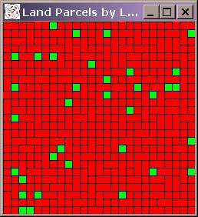
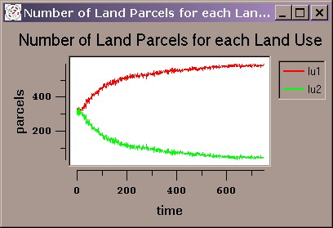
Example of Hidden Assumptions
Effect of limited accuracy of floating point arithmetic in simulation models
Showed this can critically effect some simulation model results
Fixes/checks to this hidden assumption are suggested
Not clear how critical this is in many simulations – in particular to the significant aspects of outcomes
J. Gary Polhill, Luis R. Izquierdo and Nicholas M. Gotts (2005) The Ghost in the Model (and Other Effects of Floating Point Arithmetic). Journal of Artificial Societies and Social Simulation vol. 8(1):5. http://jasss.soc.surrey.ac.uk/8/1/5.html

Slide 13
Integrate evidence into a coherent framework simulation
How thoroughly and carefully has the evidence been collected and documented?
Has the simulation been validated/checked against evidence in many different ways and at many different levels?
What in the simulation is not representative of the evidence? What ‘filler’ is there?
How useful is the resulting simulation?
Is it then used in other studies? (or has the potential to be so used)
Does it reveal new and important questions?

Slide 14
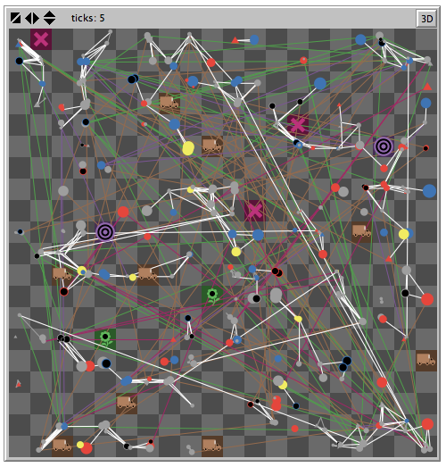
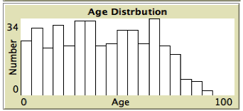
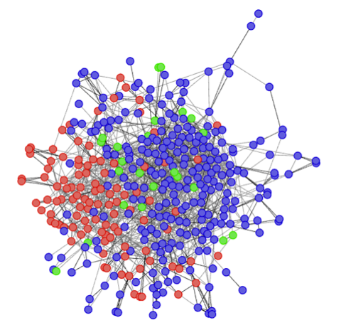
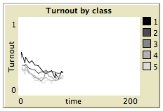
Example of Coherent Picture Simulation
Aims to integrate as much of the evidence that relates to voter turnout and the social factors that influence it
Assumptions are being documented but there are many evidential gaps
Model is beginning to be validated in multiple ways
As part of the SCID it will be analysed by physicists
How and in what way it might be used (or models based upon it might be used) for exploring policy issues is not yet determined!
Work ongoing, not yet published

Slide 15
Some Fundamental Mistakes
Unclear simulation goals
Confusion of private knowledge (improved intuition, conceptual frameworks etc.) and public knowledge (reliable results, hypotheses, solutions, models etc.)
A conflation of what is happening in the observed phenomena and what is happening in the model
Have an idea and simply animate it without real results
Make variation of existing simulation and explore it slightly – reporting what is done, rather than what might be useful to others

Slide 16
Crucial Questions to Ask
Are the authors clear about their simulation goals?
What added-value did the model provide in terms of our collective knowledge?
In other words, what do the authors claim to show with the model that we would not (or could not) know without it?
Do the authors convincingly demonstrate that the model does, in fact, show this? (so that we know its not the result of an error or simulation artifact)
What auxillary assumptions does one need to accept for this demonstration to be convincing?

Slide 17
The End
Introduction to Social Simulation Course Page
http://sites.google.com/site/socialsimulationcourse
Bruce Edmonds
http://bruce.edmonds.name
Centre for Policy Modelling
http://cfpm.org
Manchester Metropolitan Business School
http://www.business.mmu.ac.uk
NeISS Portal
http://www.neiss.org.uk

