Slide 1
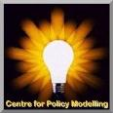
2-Day Introduction to Agent-Based Modelling
Day 2: Session 6
Mutual adaption
Notes:
Introduce me and the CPM
Complexity Group and Grant Proposal with ISC

Slide 2
Q&A of experienced modellers

Slide 3
Mutual Adaption and Emergence
Many interesting cases come about when agents are mutually adapting, so that the resultant organisation or social structure results from this mutual adaption
However such a process can be difficult to predict from the initial conditions, this is called “emergence”
Chance developments during the development of such organisation can determine which of several possible outcomes result
Sometimes there are several, quite different, kinds of outcome that can occur from the same start
In such situations, averaging the results from many runs is not helpful, indeed can be very misleading – better to try to characterise the different “phases”

Slide 4
Simulation of Influence with a Group
Model originated from an EU project looking at how information disseminated to farmers
They noticed in meetings that opinions often diverged into contrasting groups
They made an abstract simulation to try and capture this phenomena
Now a great family of related models along these lines, called “opinion dynamic” models
This is a simplified version of one of these

Slide 5
Details of this Influence Simulation
Agents all have different levels of:
agreement on an issue, represented by a number -1 to 1
uncertainty about their opinion, represented by a number from 0 to 2
Each iteration one (randomly picked) agent is randomly paired with another
That other influences their opinion and uncertainty, but only if the other’s opinion is sufficiently close to their own (difference is less than their uncertainty)
There are some “extremists” who are divided between those with opinion 1 and -1 initially
And “moderates” who have a random opinion initially
This is a simple version of an existing model (see Info)
There are many, many variants of these!

Slide 6
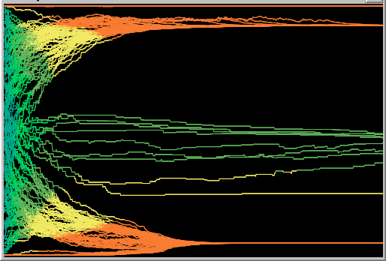
An example of what happens
The COLOUR of each is their level of uncertainty, from blue (maximally uncertain) to red (minimally uncertain)
Each line shows the “trajectory” of a single agent
The vertical scale represents the opinion of each, from -1 up to 1
In this case (roughly) two groupings with “extreme” certain views emerged
(Simulation) time is this axis

Slide 7
The Consensus Simulation
Load the “6-consensus.nlogo” simulation
“prop-of-extremists” is the proportion of extremists in the initial population
“uncert-of-moderates” is the initial uncertainty of the moderates (initial uncertainty of extremists is fixed at 0.05)
“speed-uncertainty-change” is how much an agent’s uncertainty is changed if influenced by another (opinion is always changed 5%)
Play with the settings, run the simulations, see how many qualitatively different kinds of outcome there are and under what conditions they tend to occur

Slide 8
Different kinds of procedure
Since the context of commands matters, whether the commands are being done within the context of an agent, the observer, a patch (or even a link) …
…it is useful to keep track of which procedure (or chunk of code) is within which kind of context
Some primitives and variables can only be used within an agent (turtle) context, others only within a patch context and others only within the observer context, etc.

Slide 9
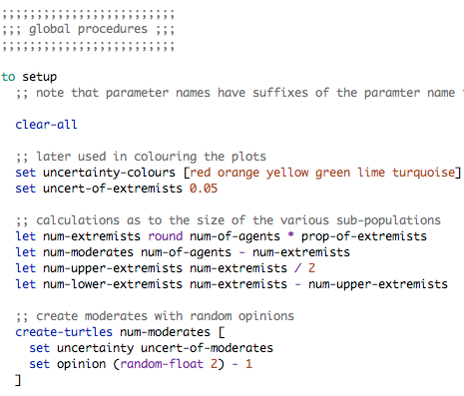
Some Global Procedures in the code
The “setup” and “go” procedures are within the observer (the global) context
But some chunks of code are within the agent context

Slide 10
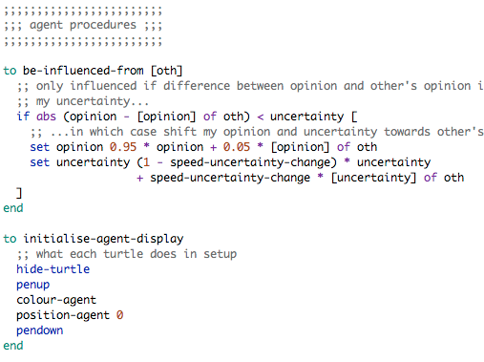
Agent procedures
A lot of the other procedures are within the agent context
Local agent variables are only usable within the agent context
Some primitives are only usable within the agent context

Slide 11
Things to try in this simulation
What might one add to help understand what is happening in the simulation?
What happens if you change code in the procedure: “be-influenced-from”?
What happens if everyone is only influenced by the nearest other?
How might you change the simulation so that everybody is influenced exactly once per simulation tick rather than one agent every tick?

Slide 12
Related models
Other models that are similar (but more complex) include:
“Bounded Confidence Opinion Dynamics” – the full opinion dynamics model with lots of options and references to original papers
“Dissemination of Culture” – a reimplementation of Axelrod’s model on this, done by programming patches rather than agents
Found in the “Extra Examples” directory

Slide 13
The End
2-Day Introduction to Agent-Based Modelling
http://cfpm.org/simulationcourse

