Slide 1
2-Day Introduction to Agent-Based Modelling
Day 2: Session 5
Variables and Debugging
Notes:
Introduce me and the CPM
Complexity Group and Grant Proposal with ISC

Slide 2
2 dimensions of code context
Being aware of what the context of any command is important to understanding it.
Which agent is doing the instruction: the observer, a kind of agent, a patch?
In which procedure/ask is it?
Example:
ask sellers [set size 50]
This bit might be in the “setup” procedure in the observer context.
This bit is is in the seller context within the ask within the “setup” procedure.

Slide 3
Variables with different scopes
Variables are simply named “slots” that remember the values you set them to. You then use them by their name but they act like the value they are currently set to. E.g.
set price 4.30
set money money + 1
show [price] of sellers
Different kinds of variable have different scopes – that is kinds of code context where they can be used by that name
Variables listed in “global” or set in the interface (using a slider etc.) are global, and can be set or used anywhere
Other variables are “local” to an agent such as color, xcor ycor, size and those listed in “…-own” in the code
Another kind are local to a procedure, defined by “let” statements within the procedure
When you use a variable that is local, which value you get is determined by the context of the statement

Slide 4
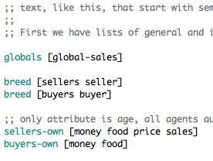
The “Market Simulation”
Load the example simulation called “5-market-begin.nlogo”
Look at the top of the code
This is a global variable, look for how it is used in the code to sum up all the sales of each seller. It is what is displayed by the “Tot.Sales” monitor in the Interface.
Here the extra variables local to each seller and buyer is listed.

Slide 5
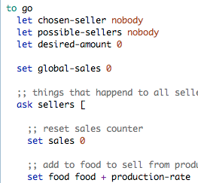
Within a procedure
Here variables that are local to the “go” procedure are defined. They only have meaning within “go” or any procedure or agent called from “go”.
Here the global variable is being set to zero at the start of a simulation time tick.
Variables local to each seller are being set and used here. Note “production-rate” can be used here because it is a global variable.

Slide 6
About the Market Simulation
There are buyers and sellers
Buyers eat a certain amount of food each time tick, and have a given income
Sellers have regular costs and production of food each time tick
Buyers see if there are any sellers with a unit of food to sell, and if so look for the cheapest seller and buys what it can afford from this seller
Sellers adjust their price depending on the level of their sales (dropping them if sales < 3 increasing them if > 6)

Slide 7
Play with the simulation
Try different values for the global parameters set by the sliders
Then step through the simulation
Inspect different agents at different stages and see what state they are in (right-click on them select seller or buyer name and then inspect)
Type in commands to query the state of the simulation, e.g.:
show [price] of sellers
show [food] of buyers
show mean [price] of sellers
show max [price] of sellers
Etc.
Try playing with the simulation again looking at the values as they change in the simulation

Slide 8
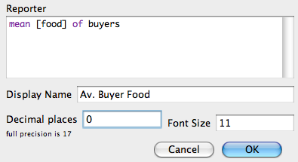
Adding Monitors
Right-click on some space and choose “Monitor”
Fill in dialogue As shown here Then “OK”
Maybe right-click on the Monitor that has now appeared and choose “select” then adjust its size and position
Make other helpful monitors for money etc.

Slide 9
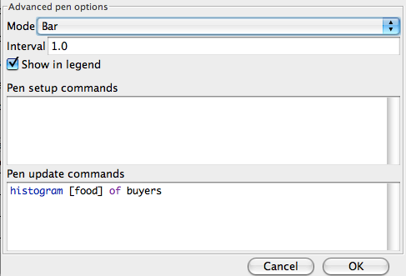
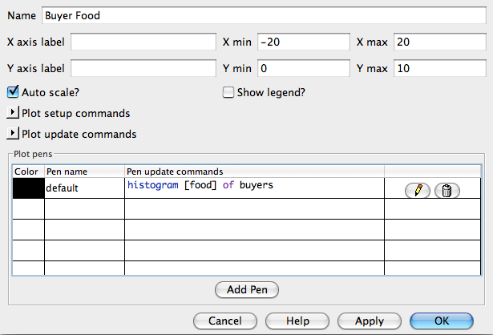
Adding graphs and histograms
Expand the whole Interface window. Then right-click on some empty space and chose “plot”. Then click on the small pencil icon in the plot dialogue and fill it in like this. Then “OK”
Then in the plot dialogue change the Name and the min and max values for the X axis. Then “OK”
Go back to the simulation and play with it again, noticing the histogram of buyer food levels. Add some more histograms for: seller prices etc. you may have to go back and adjust ranges of X/Y axes.

Slide 10
Some things to aim for…
What additional aspects could you add to the simulation to make it more realistic?
Can you change the simulation so that buyers/sellers act more rationally?
What happens if you “kill off” buyers with food < 0? (ask buyers with [food < 0] [die])
What happens if you “kill off” sellers that go bankrupt (money < 0)?
What behaviours lead to better/more stable market outcomes (i.e. without huge stocks of food, money, negative food etc.)?

Slide 11
Discussion – what were the main difficulties?

Slide 12
Stage of Debugging
Most coding time is not spent making the original simulation but in “fixing” it or adding more code in (e.g. plots, new aspects)
More careful design can help reduce time spent debugging but it still dominates
There are different stages of debugging (in order of both occurrence and difficulty):
Fixing syntax errors so the code runs
Making the micro-level behaviours work as you intended them to (verification)
Making the resultant outcomes be as you want them to be (tuning and validation)

Slide 13
Strategies for debugging
Keep adding more graphs, monitors, visualisations etc. so you better understand what is happening
Turn parts of the behaviours “off” by temporarily changing the code (e.g. make all prices fixed) to see what happens
Temporarily adding “show” statements into the code to show what is happening, e.g.
show (word "Food of " self " is " food)

Slide 14
Agent Case Studies
Global outputs such as graphs, monitors, visualisations can only go so far…
There is often nothing else for it but to follow a particular agent step by step checking what it does and its state each time compared to the code
This is time-consuming and everybody tries to avoid doing it…
…you often will simply not really understand your simulation unless you do!

Slide 15
The End
2-Day Introduction to Agent-Based Modelling
http://cfpm.org/simulationcourse

