Slide 1
2-Day Introduction to Agent-Based Modelling
Day 1: Session 1
Introduction, commands, loops, conditionals
Notes:
Introduce me and the CPM
Complexity Group and Grant Proposal with ISC

Slide 2
Welcome
It is organised and run by
Bruce Edmonds from the Centre for Policy Modelling at the Manchester Metropolitan University
and GertJan Hofstede from the XXX of Wageningen University
With help from Gary Polhill of the James Hutton Institute in Aberdeen.

Slide 3
Course Aims
To introduce you to programming and debugging agent-based modelling (ABM) through the NetLogo programming language
To give you an idea of some of the things that ABM can represent and how this is done
To give you an insight into the ABM way of thinking about social phenomena
To help you understand the process of designing, programming and using an ABM
To show you some examples of how ABM has been used in the social science literature and research

Slide 4
What it will not do…
Is make you a full agent-based programmer
An expert at NetLogo
Able to rush off and immediately write a ‘blockbuster’ ABM paper
Be able to immediately program what you have in mind to model
Sorry! These take time and some patience to achieve, but we hope to have started you on the road in these directions.

Slide 5
Course Style is…
Relaxed! Please feel free to experiment, deviate from the course material, ask questions from the helpers, generally making the course maximally useful for you
We will have quite a range of previous computer programming experience among the participants so it is inevitable that some will find some of this a bit slow (if so experiment and extend your knowledge, making use of the helpers around and suggestions for extension), and some will find parts a bit fast (if so ask for lots of help from the helpers and simply don’t worry about it but go at your own pace)
Each session will start with an example model, with some explanation/directions from the front, but with suggestions for additional things to do within each model, a model with the additions is also provided
It is in the fundamental nature of programming that not everything is obvious – even when you have read the manual – so do ask a helper when you get stuck

Slide 6
Schedule, Course Material, etc….
Are ALL freely available at: http://cfpm.org/simulationcourse
(there will be a minimum of paper distributed)
That site has pointers to:
The schedule which has pointers to:
The example models
These slides
Further material on the web
The Facebook group for the course, which you can join and post discussion points as you go along,: flattery, useful links, etc. (linked to from the course website, you have to go to the page and request an invite!)

Slide 7
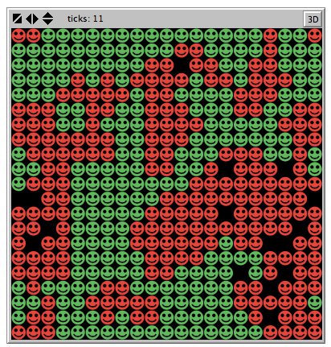
A Classic Example of an Agent-Based Model: Schelling’s Segregation Model
Schelling, Thomas C. 1971. Dynamic Models of Segregation. Journal of Mathematical Sociology 1:143-186.
Rule: each iteration, each dot looks at its 8 neighbours and if, say, less than 30% are the same colour as itself, it moves to a random empty square
Segregation can result from wanting only a few neighbours of a like colour

Slide 8
Staring the first NetLogo Model
If you have not installed NetLogo, please ask for help doing this now
Download and run the “1-commands-begin.nlogo” model
All example models are linked from the session page on the web, along with all other material for that session

Slide 9
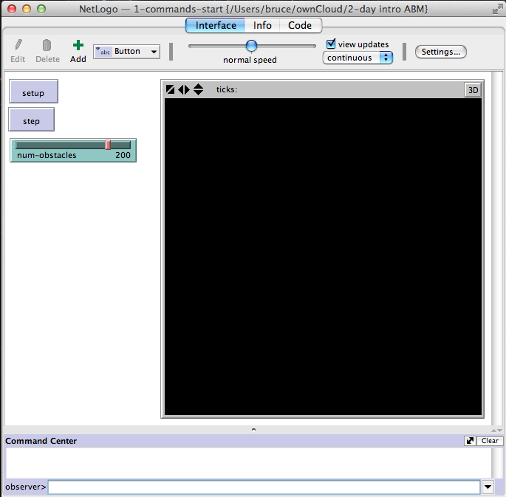
NetLogo – Interface Panel
Panel Selection (looks slightly different on Windows and Macs)
Command Buttons
Parameter Slider
Speed Control
Typed Direct Commands
Text Output

Slide 10
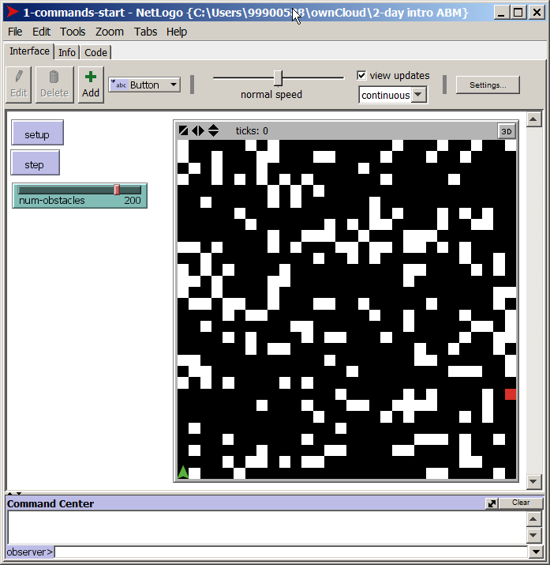
Typing in Commands
Press “setup” to initialise world
World with different colour patches
An agent!
Type commands in here as follows…

Slide 11
The command centre…
“show” means show the result in the command centre
Try:
show timer (and then try this again)
show count agents
show agents
show sort agents
show count patches
show count patches with [pcolor = white]
Anything typed into the command centre is from the “observer” point of view (yours!)

Slide 12
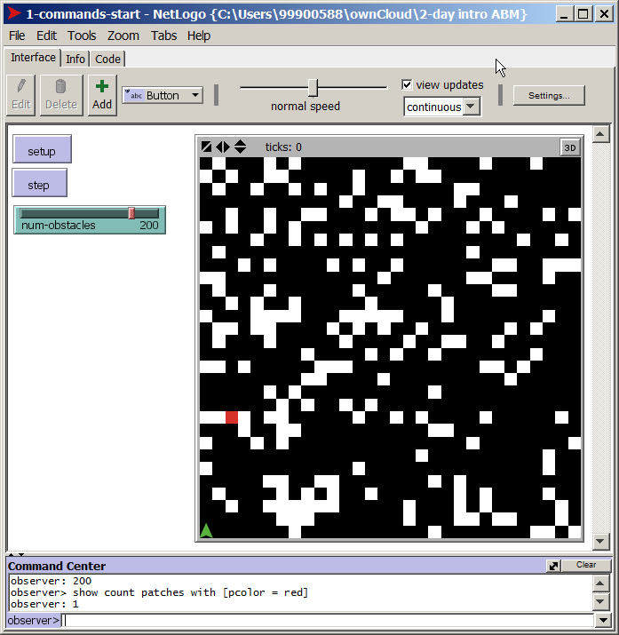
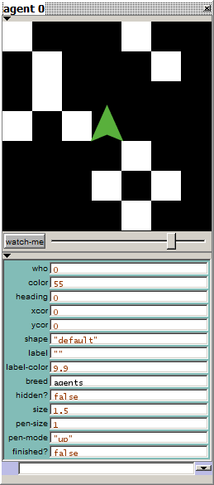
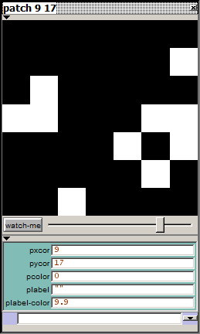
Inspecting Patches and Agents
Right-click (or ctrl click) on a patch, then “inspect” that patch
Right-click (or ctrl click) on a agent, then “inspect” that agent
Click on little “x” in corner to get rid of inspector
Try typing commands to agent, e.g.:
show who
fd 1
fd 2
rt 90
lt 90
fd 1 rt 90 fd 1
set color violet
set size 4
Magnified View
Properties of patch
Type commands to patch here, e.g. set pcolor red

Slide 13
Some important ideas
The whole world, the turtles, the patches (and later the links) are “agents”
That is, they:
have their own properties
can be given commands
can detect things about the world around them, other agents etc.
But these are all ultimately controlled from the world (from the view of the observer)
It is the world that is given the list of instructions as to the simulation, which then sends commands to patches, agents (and links) using the “ask” command

Slide 14
Using “ask”
Try typing commands to agents via the world, e.g.:
ask agents [fd 1]
ask agents [set color grey]
ask agents [set shape “person”]
ask agents [fd 1 rt 90 fd 1]
ask agents [show patch-here]
etc.
Can also ask patches:
ask patches [show self]
ask patches [set pcolor black]
ask patch 0 0 [show agents-here]

Slide 15
Running a simulation (the hard way!)
1. Move the slider to change parameter
2. Press “setup” to initialise world
3. Press “step” to make the program run one time step
4. Press “step” lots of times!!
Each time “step” is pressed the procedure called “go” is caused to run – this is a list of commands, a program.
We will now look at this.

Slide 16
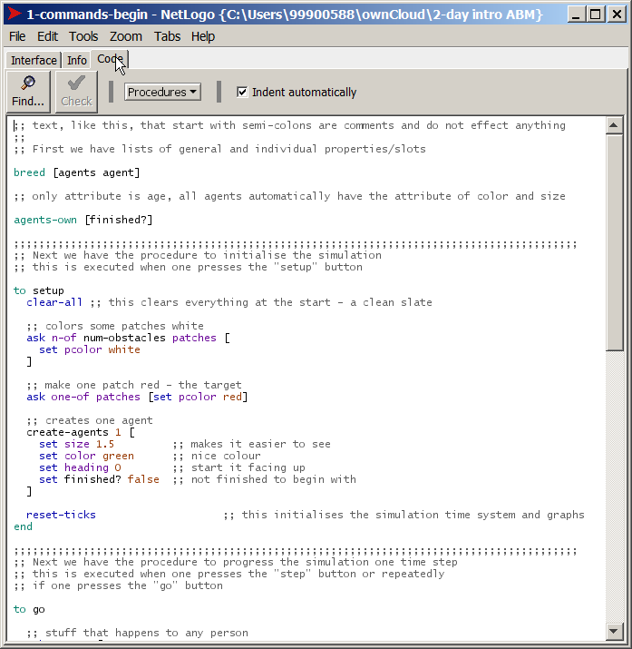
The Program Code
Click on the “Code” tab to see the program
This text is the program
It has different parts
This chunk of code (from “to” to “end”) is the “setup” procedure – what happens when you press the setup button
Text that if after a semi-colon “;” are comments and have no effect
Scroll down to look at the “go” procedure – this is what the “step” button does

Slide 17
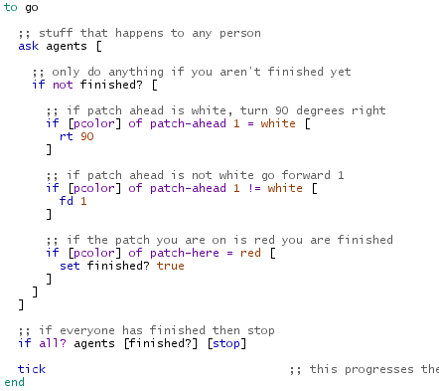
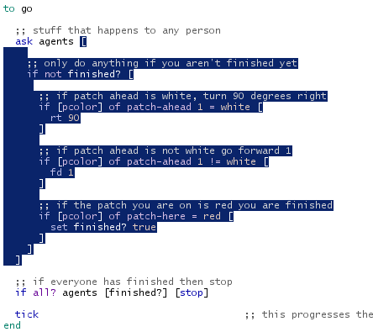
Parts of the Code
“ask agents” means to ask (all) agents to do some code, one after the other
All the square brackets inside each other can be confusing, if you double-click just outside a bracket, it shows what is in side between it and the matching bracket
What it is asking them all to do is between the square brackets “[ …. ]”
Everything between “to” and “end” defines what “go” means
“if” statements are conditionals they have a condition and an action

Slide 18
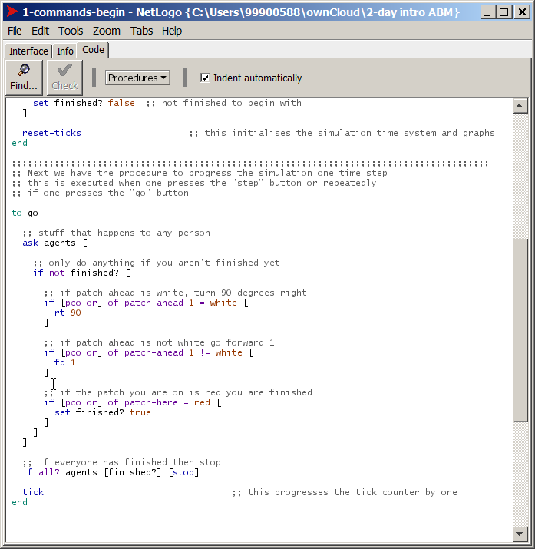
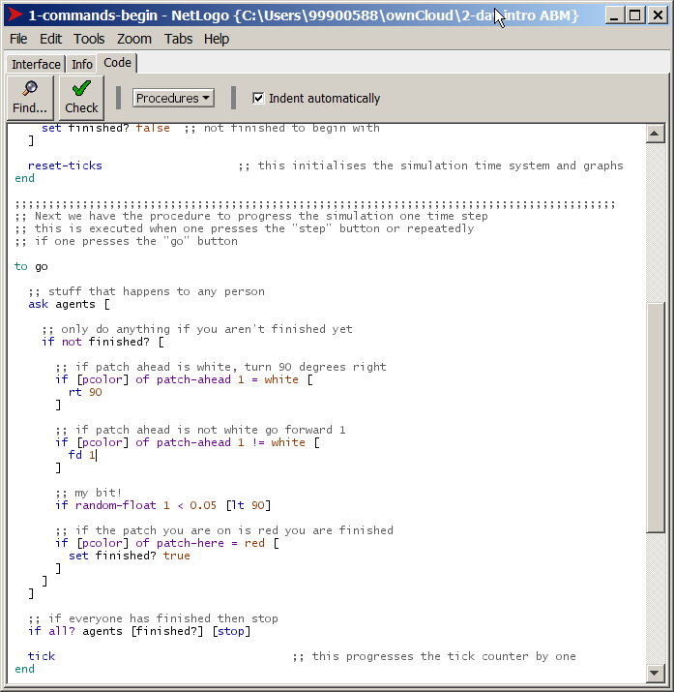
To change the program…
You can press “Check” to see if you got the syntax of everything right!
If all is well you can then click on “Interface” to go back and try the effect of your change when running the code (pressing the “step” button)
Click within the text and type!
type the following:
;; my bit!
if random-float 1 < 0.05 [lt 90]

Slide 19
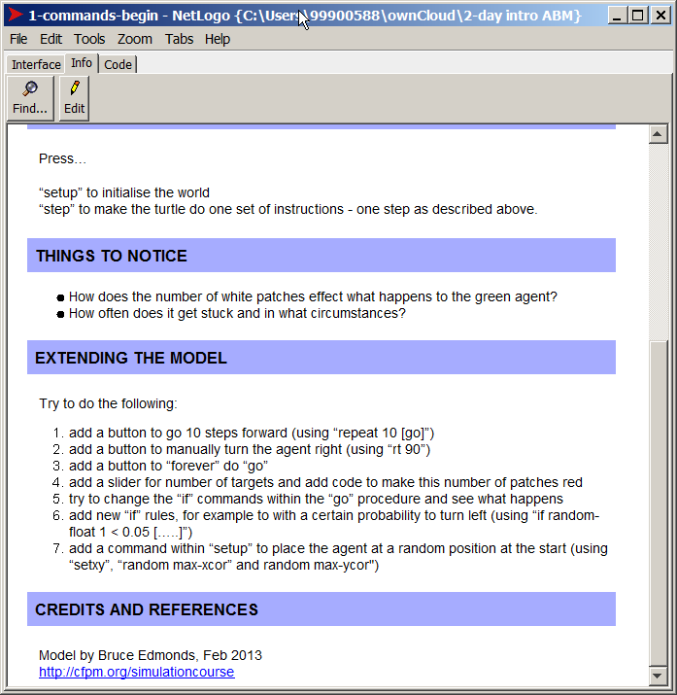
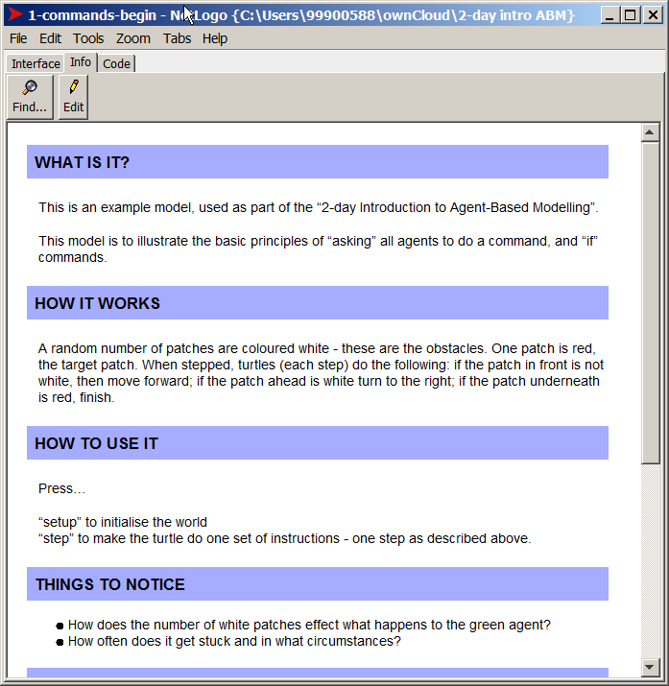
The Information Tab
Click on the “Info” tab to see a description of the model (or whatever the programmer has written, if anything!)
Read it, scrolling down
Here are some suggestions of bits of code to add and things to try (in a bit!)

Slide 20
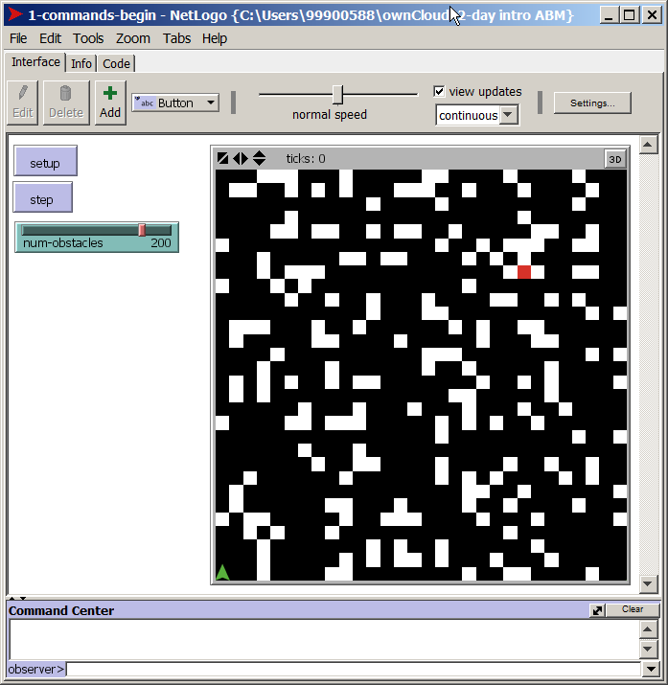
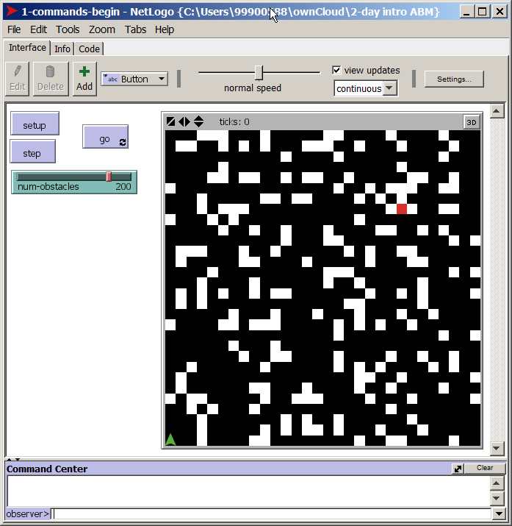
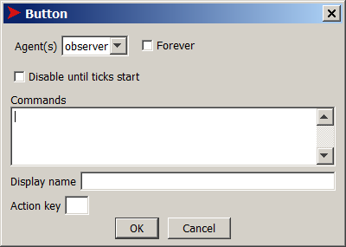
Adding a button and running the code (the fast way!)
Click on the “Interface” tab to get back to the main view
Right-Click some empty space and choose “button”
Type the text “go” here and then check (to on) the “forever” switch then “OK”
Now when you press the “go” button it will keep doing doing the “go” procedure forever (until you “unpress” it)

Slide 21
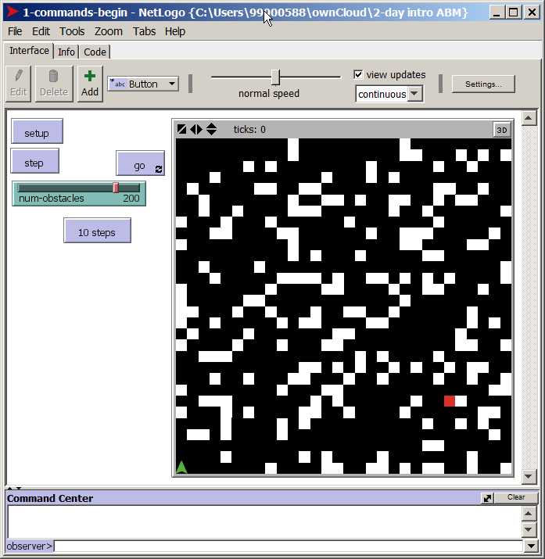
Adding a button and running the code for only 10 steps
Right-Click some different empty space and choose “button”
Type the text “repeat 10 [go]” here
Type the text “10 steps” here and then “OK”
Now when you press the “10 steps” button it will do the “go” procedure only 10 times

Slide 22
The Experimentation Cycle
Often programming, especially in the exploratory phase, involves a cycle of:
Writing some code
Trying it out (as part of a program or as a direct command)
Finding errors
Reading the NetLogo documentation (more on this next session)
Correcting Errors
Until it works as you want it to (if ever!)

Slide 23
Things to try…
Try to do the following:
add a button to manually turn the agent right (using “rt 90”)
add a slider for number of targets and add code to make this number of patches red
try to change the “if” commands within the “go” procedure and see what happens
add new “if” rules, for example to with a certain probability to turn left (using “if random-float 1 < 0.05 […..]”)
add a command within “setup” to place the agent at a random position at the start (using “setxy”, “random max-xcor” and random max-ycor")

Slide 24
The End
2-Day Introduction to Agent-Based Modelling
http://cfpm.org/simulationcourse

