Slide 1
Multi-Patch Cooperative Specialists With Tags Can Resist Strong Cheaters
Bruce Edmonds
Centre for Policy Modelling Manchester Metropolitan University

Slide 2
Context
Aim: Understanding why and how distributed systems (social systems, ecological systems, p2p systems etc.) might be vulnerable to subversion by hostile/selfish agents.
This does not prove what might be happening in existing observed systems.
In such systems the detail of how individuals interact over the network matters
Thus a more descriptive, individual-based simulation are required
Many micro-level, structural mechanisms have been suggested, here we look at a particular one… “tags”

Slide 3
About ‘tags’
Idea proposed by John Holland in 1993
Tags are socially observable cues…
…that can be used as a (fallible) guide as to group membership/whether to cooperate …
…depending on how “close” they are to one’s own (set of) tags.
I.e. the rule is: cooperate with those with similar tags
Can be implemented in several different ways
Are not necessarily unique to an individual – they can be “forged” by others
Are not “hard-wired” to any other characteristics of the individuals who have them

Slide 4
When donations occur between individuals
Tag value
Tolerance value
Range of tag values

Slide 5
Brief Review of Single Patch Symbiosis Model
This kind of tag mechanism used in:
Riolo, R. L., Cohen, M. D. and Axelrod, R. (2001) Evolution of cooperation without reciprocity. Nature, 411:441-443.
But this was flawed – it relied upon forced donation to ‘tag clones’:
Roberts & Sherratt 2002, Edmonds & Hales 2003
Led to development of the single patch symbiosis model discussed here:
Edmonds, B. (2006) The Emergence of Symbiotic Groups Resulting from Skill-Differentiation and Tags. Journal of Artificial Societies and Social Simulation 9(1), 10, http://jasss.soc.surrey.ac.uk/9/1/10.html.

Slide 6
Basic Design Ideas – static structure
Discrete time simulation
There are a variable number of individuals
There are n (necessary) food types
Each individual has:
A limited store for each food type (1 when new)
One skill, it can gather only one type of food
A tag value in [0, 1]
A tolerance value in [0, 1]
The tag and tolerance may be mutated during reproduction

Slide 7
Each iteration individuals:
two new random individuals enter from outside
get some randomly distributed food depending on their skill
are randomly paired p times
will donate share of some of any excess of each store to those paired with if other’s tag is within its tolerance to its own tag (get 95% of value)
all stores taxed 0.25; die if any ≤ 0, reproduce if all > 4

Slide 8
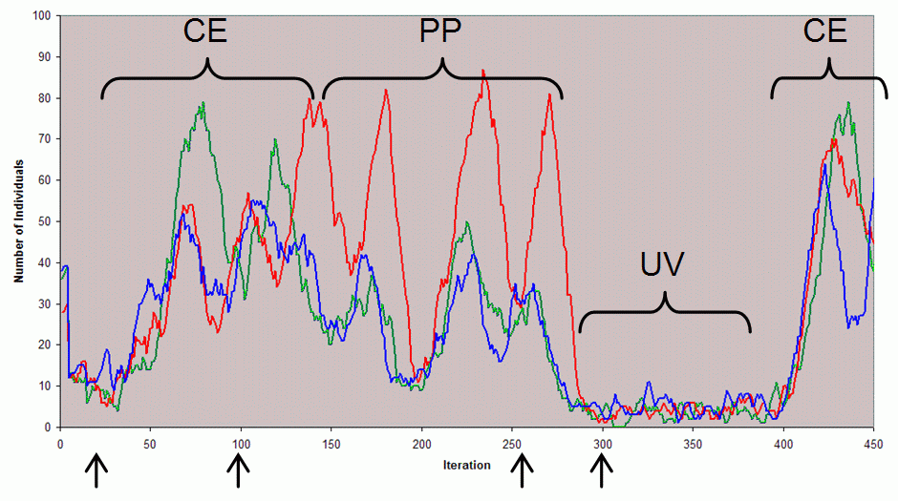
Typical dynamics of the Single Patch
Simulation Time

Slide 9
Limitations of Single Patch Model
Relies on assumption of forced specialisation of nutrient foraging
Cooperation collapses of its own internal accord after a while
‘Winner takes all’ group dynamic prevents multiple tag groups in same patch
Thus the original single patch model needed ‘re-seeding’ to start it up again
Turns out it is also vulnerable to introduction of zero-tolerance cheaters

Slide 10
Kinds of Cheater
Shutters, S. and Hales, D. (2013) Tag-Mediated Altruism is Contingent on How Cheaters Are Defined. Journal of Artificial Societies and Social Simulation 16(1), 4, http://jasss.soc.surrey.ac.uk/16/1/4.html.
Pointed out that some existing tag-based models only succeeded against injection of relatively weak kinds of “cheater”
Defined “strong cheaters” as those who were fixed with zero tolerance and this was passed to any offspring as fixed zero tolerance etc.
Even when a very few strong cheaters (say 0.1%) were introduced into an evolutionary system in an one-time injection cooperation collapsed completely
Speculated that multi-level selection would resist such strong cheaters.

Slide 11
The Multi-Patch Version
A 2D grid of such patches with:
(usually slow) rates of random migration between neighbouring patches
Possibility of mutation to strong cheaters (which then can not mutate back) via a probability that any new individual (introduced or born) is a strong cheater
Random new individuals only at the start until an initial viable population is reached

Slide 12
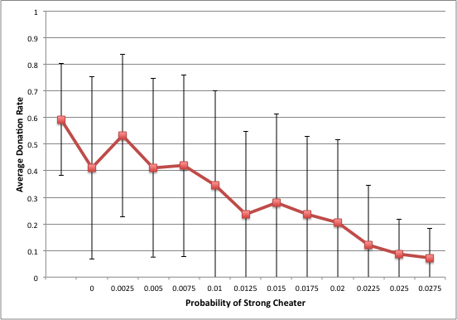
Donation Rate vs. Cheater Prob.

Slide 13
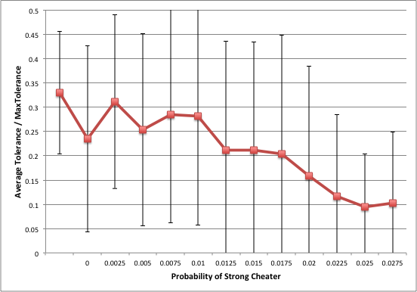
Tolerance vs Cheater Prob

Slide 14
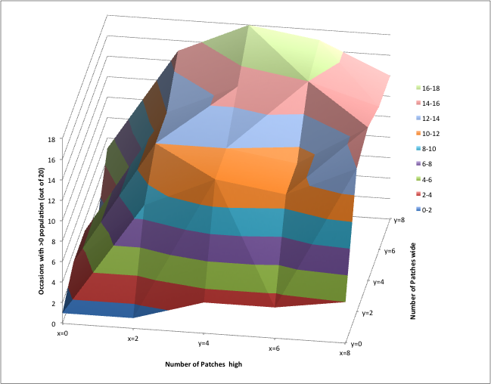
With 1% prob. of strong cheaters

Slide 15
The End
Bruce Edmonds http://bruce.edmonds.name
Centre for Policy Modelling http://cfpm.org
The SCID Project http://scid-project.org

